Slide 2
Psalm 23
¹ The LORD is my shepherd; I shall not want. ² He maketh me to lie down in green pastures: he leadeth me beside the still waters. ³ He restoreth my soul: he leadeth me in the paths of righteousness for his name’s sake. ⁴ Yea, though I walk through the valley of the shadow of death, I will fear no evil: for thou art with me; thy rod and thy staff they comfort me. ⁵ Thou preparest a table before me in the presence of mine enemies: thou anointest my head with oil; my cup runneth over. ⁶ Surely goodness and mercy shall follow me all the days of my life: and I will dwell in the house of the LORD for ever.

Slide 3
The Good Shepherd
JOHN 10:1-13

Slide 4
John 10:1-13

Slide 5
Shepherding In Old Testament
Large flocks were a symbol of wealth (Abraham)
Sons and even daughters shepherded the flocks
Laban’s daughter Rachel – Genesis 29:9
Jacob’s son Joseph - Genesis 37:2
Jesse’s son David – I Samuel 16:9, 17:20
Nomadic – Moved with the families from place to place
Resident – Owned by a family that was a resident of a local town or village.

Slide 6
Shepherding In New Testament
Shepherds ranged in economic status
Wore mantels of sheep’s wool (Jeremiah 43:12)
Carried a Wallet or Sack (I Samuel 17:40)
Weapons
Sling – Fight off predators and theives
Staff – Guide and rescue sheep
Rod – Used for counting
Sheepfold
Holding the sheep at night for protection
Watchmen

Slide 7
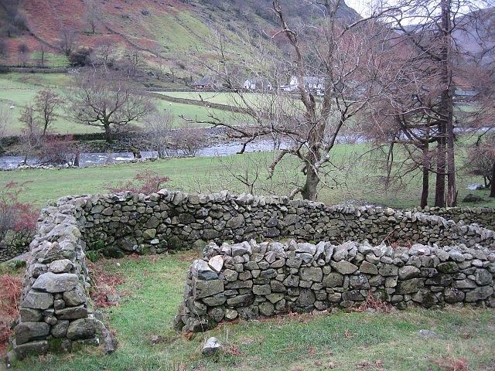
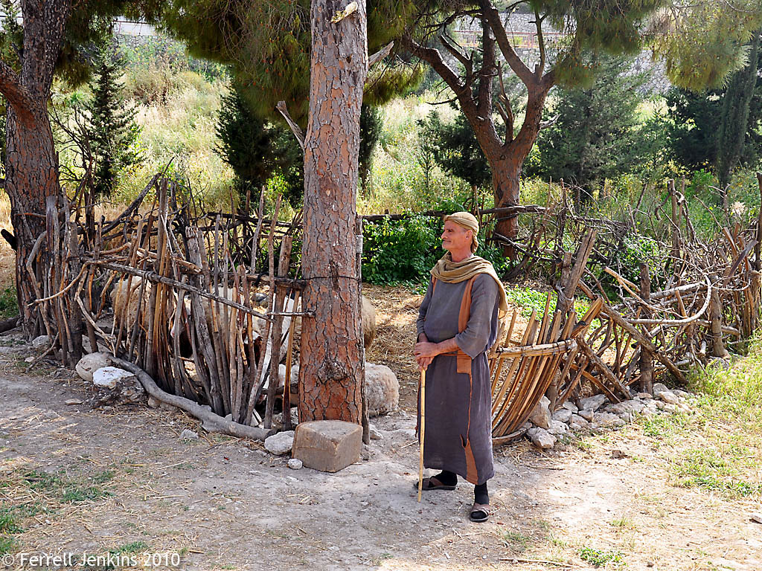

Slide 8
John 10:1-10

Slide 9
The Good Shepherd
The sheep hear and recognize the shepherd’s voice (vs. 1-6)

Slide 10
John 8:47
“He who belongs to God hears what God says. The reason you do not hear is that you do not belong to God.”

Slide 11
I Corinthians 2:9-12
9 However, as it is written: “No eye has seen, no ear has heard, no mind has conceived what God has prepared for those who love him” 10 but God has revealed it to us by his Spirit. The Spirit searches all things, even the deep things of God. 11 For who among men knows the thoughts of a man except the man’s spirit within him? In the same way no one knows the thoughts of God except the Spirit of God. 12 We have not received the spirit of the world but the Spirit who is from God, that we may understand what God has freely given us.

Slide 12
The Good Shepherd
The sheep hear and recognize the shepherd’s voice (vs. 1-6)
The shepherd leads – the sheep follow (vs. 4)

Slide 13
Romans 6:16-18
16 Don’t you know that when you offer yourselves to someone to obey him as slaves, you are slaves to the one whom you obey—whether you are slaves to sin, which leads to death, or to obedience, which leads to righteousness? ¹⁷ But thanks be to God that, though you used to be slaves to sin, you wholeheartedly obeyed the form of teaching to which you were entrusted. ¹⁸ You have been set free from sin and have become slaves to righteousness.

Slide 14
The Good Shepherd
The sheep hear and recognize the shepherd’s voice (vs. 1-6)
The shepherd leads – the sheep follow (vs. 4)
The shepherd leads the sheep to good pastures (vs. 9-10)

Slide 15
Matthew 7:9-11
⁹ “Which of you, if his son asks for bread, will give him a stone? ¹⁰ Or if he asks for a fish, will give him a snake? ¹¹ If you, then, though you are evil, know how to give good gifts to your children, how much more will your Father in heaven give good gifts to those who ask him!

Slide 16
Romans 8:28
And we know that in all things God works for the good of those who love him, who have been called according to his purpose.

Slide 17
The Good Shepherd
The sheep hear and recognize the shepherd’s voice (vs. 1-6)
The shepherd leads – the sheep follow (vs. 4)
The shepherd leads the sheep to good pastures (vs. 9-10)
The shepherd is willing to lay his life down for his sheep (vs. 11-13)

Slide 18
Romans 5:6-8
⁶ You see, at just the right time, when we were still powerless, Christ died for the ungodly. ⁷ Very rarely will anyone die for a righteous man, though for a good man someone might possibly dare to die. ⁸ But God demonstrates his own love for us in this: While we were still sinners, Christ died for us.

Slide 19
Psalm 23
God, my shepherd! I don’t need a thing. You have bedded me down in lush meadows, you find me quiet pools to drink from. True to your word, you let me catch my breath and send me in the right direction. Even when the way goes through Death Valley, I’m not afraid when you walk at my side. Your trusty shepherd’s crook makes me feel secure. You serve me a six-course dinner right in front of my enemies. You revive my drooping head; my cup brims with blessing. Your beauty and love chase after me every day of my life. I’m back home in the house of God for the rest of my life.

