Slide 2
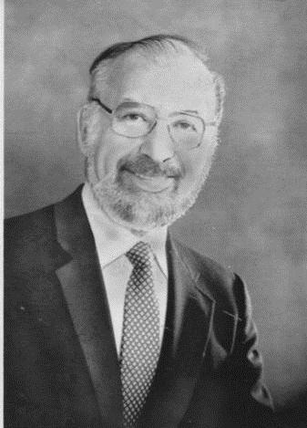
Arland D. Williams Jr.

Slide 3
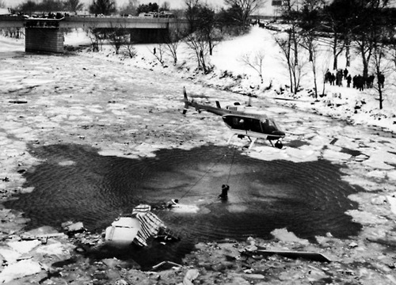
Air Florida Flight 90 Crash Site
Potomac River – Jan 13th, 1982
Arland Williams

Slide 4
I Choose to Die
JOHN 10:14-21

Slide 5
John 10:14-15
“I am the good shepherd; I know my sheep and my sheep know me— ¹⁵ just as the Father knows me and I know the Father—and I lay down my life for the sheep.
NASB

Slide 6
Jesus wants a relationship with us that is intimate like the relationship He has with God the Father!

Slide 7
Ephesians 3:14-19
¹⁴ For this reason I kneel before the Father, ¹⁵ from whom his whole family in heaven and on earth derives its name. ¹⁶ I pray that out of his glorious riches he may strengthen you with power through his Spirit in your inner being, ¹⁷ so that Christ may dwell in your hearts through faith. And I pray that you, being rooted and established in love, ¹⁸ may have power, together with all the saints, to grasp how wide and long and high and deep is the love of Christ, ¹⁹ and to know this love that surpasses knowledge—that you may be filled to the measure of all the fullness of God.
NASB

Slide 8
John 10:16
“I have other sheep that are not of this sheep pen. I must bring them also. They too will listen to my voice, and there shall be one flock and one shepherd.”
NASB

Slide 9
Matthew 10:5-6
These twelve Jesus sent out after instructing them: “Do not go in the way of the Gentiles, and do not enter any city of the Samaritans; but rather go to the lost sheep of the house of Israel.
NASB

Slide 10
Ephesians 2:11
Therefore remember that formerly you, the Gentiles in the flesh, who are called “Uncircumcision” by the so-called “Circumcision,” which is performed in the flesh by human hands…
NASB

Slide 11
John 10:17
“The reason my Father loves me is that I lay down my life—only to take it up again.”
NASB

Slide 12
Jesus is making a statement about just one of the many intimate aspects of the relationship He shared with God the Father.

Slide 13
John 10:18
¹⁸ No one takes it from me, but I lay it down of my own accord. I have authority to lay it down and authority to take it up again. This command I received from my Father.”
NASB

Slide 14
Jesus Chose to Die
Matthew 26:52 52 “Put your sword back in its place,” Jesus said to him, “for all who draw the sword will die by the sword. Do you think I cannot call on my Father, and he will at once put at my disposal more than twelve legions of angels? But how then would the Scriptures be fulfilled that say it must happen in this way?”
Luke 22:42 “Father, if you are willing, take this cup from me; yet not my will, but yours be done.”
Ephesians 5:1-2 – Be imitators of God, therefore, as dearly loved children and live a life of love, just as Christ loved us and gave himself up for us as a fragrant offering and sacrifice to God.
NASB

Slide 15
Mark 16:15-16
¹⁵ He said to them, “Go into all the world and preach the good news to all creation. ¹⁶ Whoever believes and is baptized will be saved, but whoever does not believe will be condemned.
NIV

