Slide 2
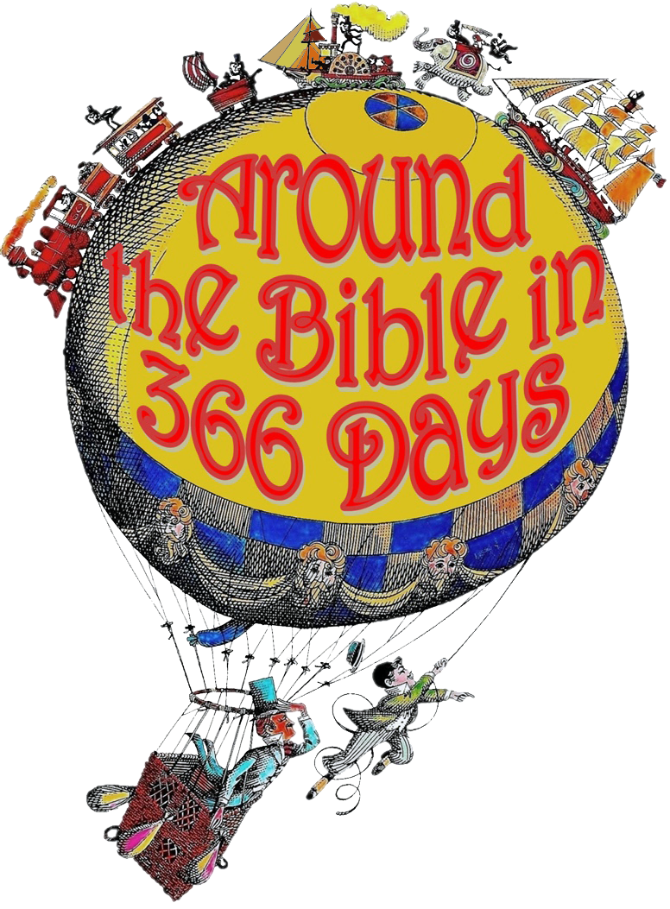
Acts 8:26-35

Slide 3
Week 33 Jesus! (Isaiah 52-53)

Slide 4
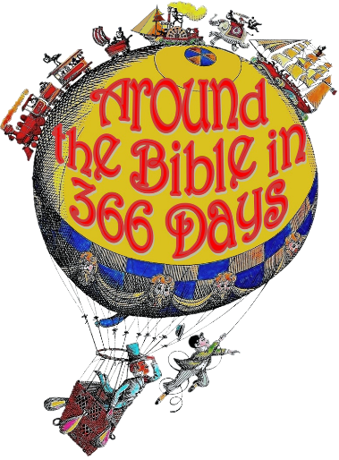
Isaiah 52:13-15; Chap. 53
Quoted or referred to in…
Matthew
Mark
Luke
John
Acts
Romans
1 Corinthians
2 Corinthians
Galatians
Ephesians
1 Timothy
Titus
Hebrews
1 Peter
1 John

Slide 5
Isaiah 52:13-15; Chap. 53
“The Servant of the Lord”
“The Arm of the Lord”
Isaiah 59:1-3, 15-16

Slide 6
Isaiah 53:1,3
He will be widely rejected
John 12:37-38 ³⁷ Even after Jesus had performed so many signs in their presence, they still would not believe in him. ³⁸ This was to fulfill the word of Isaiah the prophet: “Lord, who has believed our message and to whom has the arm of the Lord been revealed?”

Slide 7
Isaiah 53:4-5
He will bear our sins and sorrows
Romans 4:25 He was delivered over to death for our sins and was raised to life for our justification.

Slide 8
Isaiah 53:4-5
He will bear our sins and sorrows
1 Peter 2:24-25 ²⁴ “He himself bore our sins” in his body on the cross, so that we might die to sins and live for righteousness “by his wounds you have been healed.” ²⁵ For “you were like sheep going astray,” but now you have returned to the Shepherd and Overseer of your souls.

Slide 9
Isaiah 53:6
He will be our substitute
Romans 5:6-8 ⁶ You see, at just the right time, when we were still powerless, Christ died for the ungodly. ⁷ Very rarely will anyone die for a righteous person, though for a good person someone might possibly dare to die. ⁸ But God demonstrates his own love for us in this: While we were still sinners, Christ died for us.

Slide 10
Isaiah 53:7
He will be silent before His accusers
Luke 23:9 He (Herod) asked Jesus question after question, but Jesus refused to answer.

Slide 11
Isaiah 53:8
He will voluntarily accept our guilt and punishment for sin
2 Corinthians 5:21 God made him who had no sin to be sin for us, so that in him we might become the righteousness of God.

Slide 12
Isaiah 53:9
He will be buried in a rich man's tomb
Jesus was buried in the tomb of Joseph, a rich man from Arimathea (Matthew 27:57-60)

Slide 13
Isaiah 53:10
He has been chosen by the will of God to die
1 Peter 1:19-20 ¹⁹ It was the precious blood of Christ, the sinless, spotless Lamb of God. ²⁰ God chose him as your ransom long before the world began, but now in these last days he has been revealed for your sake.

Slide 14
Isaiah 53:11-12
He will save us who believe in Him
Acts 16:31 They replied, “Believe in the Lord Jesus, and you will be saved—you and your household.”
John 3:16 For God so loved the world that he gave his one and only Son, that whoever believes in him shall not perish but have eternal life.

Slide 15
Isaiah 53:12
He will intercede for sinners
Romans 8:33-34 ³³ Who will bring any charge against those whom God has chosen? It is God who justifies. ³⁴ Who then is the one who condemns? No one. Christ Jesus who died—more than that, who was raised to life—is at the right hand of God and is also interceding for us.

Slide 16
Question:
How can a sinner be right with God?
Answer:
Because Jesus became a substitute and suffered the judgment of God in the sinner’s place

