Slide 2
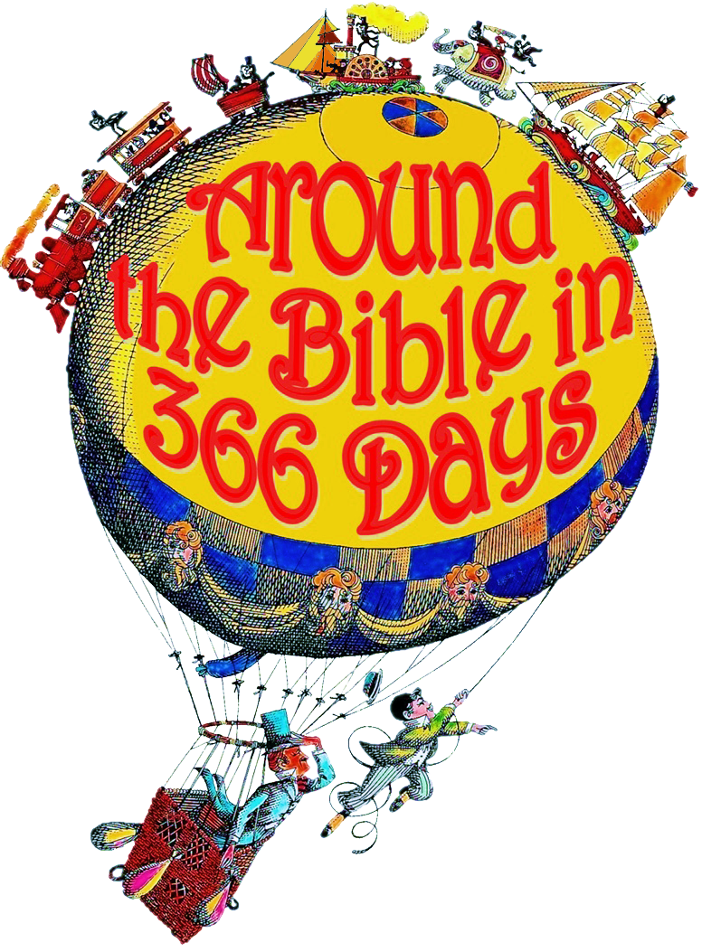
Week 38 I Will Not Bow! (Daniel 3)

Slide 3
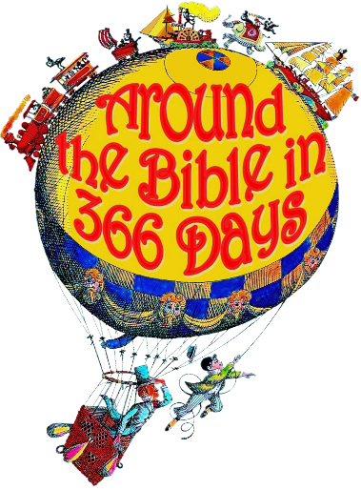
Daniel 3
Bowing down implies worship
our thoughts, deeds, actions, attitudes, and priorities
what we derive pleasure, happiness, and worth from
To bow down indicates two things:
Respect
Submission

Slide 4
Daniel 3
Idol
a person or thing that is greatly admired or loved
something used as an object of worship
anything that replaces the one, true God
Can you imagine their fear?
What if they rationalized?

Slide 5
Daniel 3
Penalty
there is an earthly penalty for not bowing down
there is a spiritual penalty for bowing down
Faith under fire
Lordship
Jesus manifests Himself in the midst of the fire!

Slide 6
Daniel 3
Nebuchadnezzar’s impressions:
He saw Jesus with them
Jesus rescued them
They put their trust in Him
They were willing to die
He was changed because of their faith (trust)

Slide 7
Forgive us of our priorities
Boldness
Faith under fire
Lordship
Renew our awe
Help us see You

