Slide 2
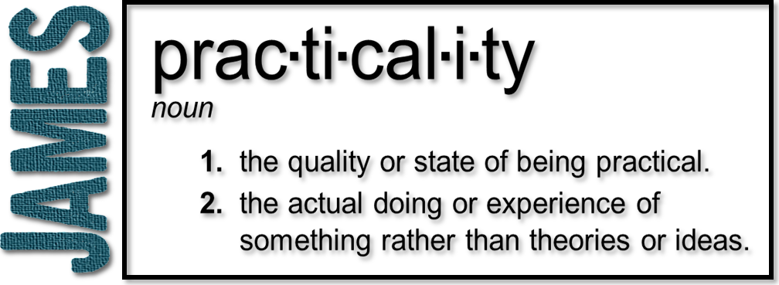
Week 4: Anger & Deception
(James 1:19-27)

Slide 3
Quick to listen

Slide 4
James concerned with what others see

Slide 5
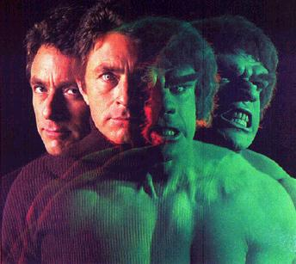
Anger

Slide 6
Anger
strong feeling of annoyance, displeasure, or hostility caused by a wrong or injustice
“When angry, count to four. When very angry, swear.”—Mark Twain
“A man is about as big as the things that make him angry”—Winston Churchill
“For every minute you are angry you lose sixty seconds of happiness.” —Ralph Waldo Emerson

Slide 7
Anger
“Speak when you are angry - and you'll make the best speech you'll ever regret.” —Dr. Laurence J. Peter
“When anger rises, think of the consequences”—Confucius
“It is wise to direct your anger towards problems—not people; to focus your energies on answers—not excuses.” —William Arthur Ward

Slide 8
Anger
“Anger, if not restrained, is frequently more hurtful to us than the injury that provokes it”—Seneca (1st century AD)
We feel these things so deeply in us. We don’t always know how to control them or process them
Much of our anger comes from being self-centered and not others-centered

Slide 9
Anger
²¹ Man’s anger does not bring about the righteous life that God desires!
Ephesians 4:26-27 (NLT) ²⁶ And “don’t sin by letting anger control you.” Don’t let the sun go down while you are still angry, ²⁷ for anger gives a foothold to the devil.

Slide 10
Anger
It is sin when…
It controls our thoughts and emotions (inward poisoning)
We have an expression of anger (outward outbursts)
Proverbs 29:11 A fool gives full vent to his anger, but a wise man keeps himself under control.

Slide 11
Deception

Slide 12
Deception
A healthy person looks in the mirror to do something, not just to admire their image
Careful scrutiny
Remembering and doing
Not reasoning out of life change

Slide 13
Transformative

