Slide 2

Week 4: Excuses, Excuses, Excuses! (Exodus 3-4)

Slide 3
Moses

Slide 4

Let the excuses begin!
“Who am I that I should…?”
God’s answer:
“I will be with you.”
“But I don’t know enough.”
God’s answer:
God gives him knowledge- Tells Moses who He is and what to do and say

Slide 5
Let the excuses begin!
“What if they don’t listen to me or believe you are in this?”
God’s answer:
“What’s in your hand? I’ll use that!”

Slide 6
Let the excuses begin!
“I’m not good with words”
Acts 7:22
Moses was educated in all the wisdom of the Egyptians and was powerful in speech and action.
Jeremiah 1:6
“Alas, Sovereign Lord,” I said, “I do not know how to speak; I am too young.”

Slide 7
Let the excuses begin!
1 Corinthians 2:1-4 (NASB)
¹ And when I came to you, brethren, I did not come with superiority of speech or of wisdom, proclaiming to you the testimony of God… ³ I was with you in weakness and in fear and in much trembling, ⁴ and my message and my preaching were not in persuasive words of wisdom, but in demonstration of the Spirit and of power.

Slide 8
Let the excuses begin!
“I’m not good with words”
God’s answer:
“Who made your mouth?”
“Go, I will teach & help you.”

Slide 9
Let the excuses begin!
“I’m not your guy, get someone else”
God’s answer:
“Here’s the second best…”

Slide 10
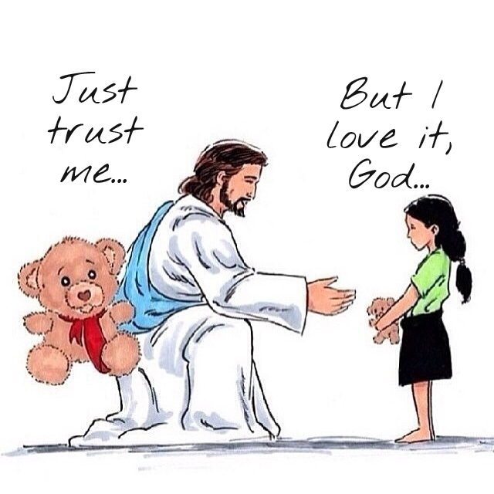

Slide 11
What excuses have you been giving?

