Slide 2
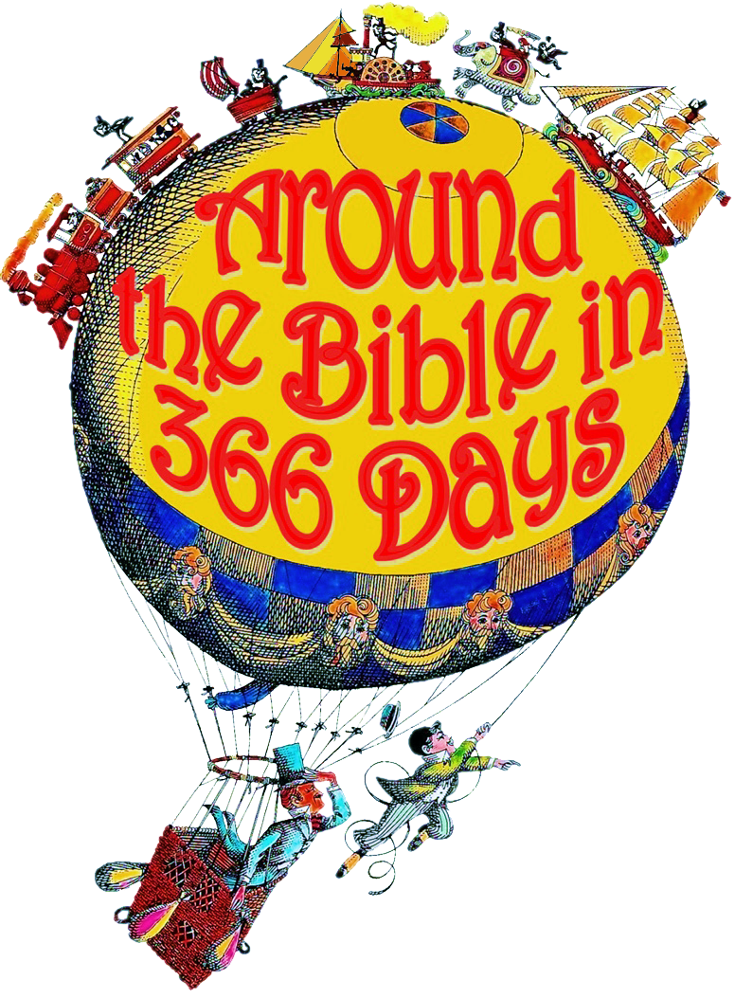
Extreme Home Makeover (Haggai)
Week 40

Slide 3
"And he (Nebuchadnezzar) carried out from there all the treasures of the house of the LORD and the treasures of the king's house, and he cut in pieces all the articles of gold which Solomon king of Israel had made in the temple of the LORD, as the LORD had said. Also he carried into captivity all Jerusalem: all the captains and all the mighty men of valor, ten thousand captives, and all the craftsmen and smiths. None remained except the poorest people of the land.“ 2 Kings 24:13-14

Slide 4
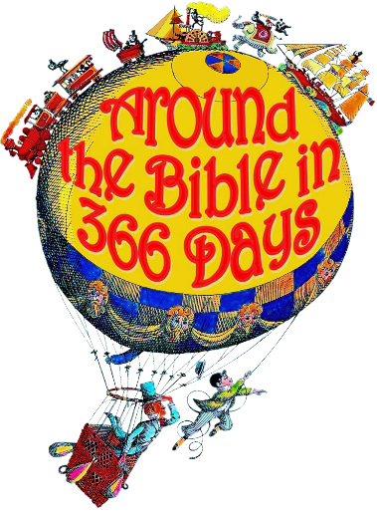
Haggai
70 years Babylonian captivity
Narrative covers the books:
II Kings, II Chron, Jeremiah, Ezekiel, Daniel, Esther, Ezra, Nehemiah, Haggai, Zechariah, Malachi
Burning of the temple in 586 B.C.
Actual release by Cyrus’ decree in 537 B.C.
Ezra 1:2-4
Reconstruction of temple completed in 516 B.C.

Slide 5
Why the delay?
Haggai rebuked Israel for their procrastination.
Why were they dragging their feet?

Slide 6
"Procrastination is my sin"
"It brings me nothing but sorrow"
"I know that I should stop it"
"In fact, I will...tomorrow.“
Gloria Pitzer

Slide 7
1. Misplaced Priorities
Time/timing
Personal comfort/pleasure
Phil 2:21 “everyone looks out for their own interests, not those of Christ”
Spiritual apathy

Slide 8
The Glory of God must be our number one priority!

Slide 9
2. Incorrect Perspective
Those who remembered Solomon’s temple compare the rebuilding plan as inferior
“The good ole days…”
“At my old church…”
“I remember when…”

Slide 10
3. Unrealistic Expectations
Expecting immediate material blessings in return for their minimal efforts

Slide 11
4. Unnecessary Fear
They were still surrounded by enemies
There were constant threats
Lack of faith in God to protect/provide for the work

Slide 12
The MAIN REASON they were not being diligent?
They were not ready to serve God again with their whole heart.
Rebuilt the Brazen altar (Works righteousness)
But to rebuild the Holy of Holies meant they would have to return to intimacy

Slide 13
v6 Ye have sown much, and bring in little; ye eat, but ye have not enough; ye drink, but ye are not filled with drink; ye clothe you, but there is none warm; and he that earneth wages earneth wages to put it into a bag with holes. 7 Thus saith the LORD of hosts; Consider your ways.

Slide 14
5. They were caught up in
Consumerism
What I like
What I want
What I think
What makes me feel good
What makes me LOOK good

Slide 15
Rebuilding I AM’s temple would symbolize: His rule over the life of His people and His prophesied rule of the entire world

Slide 16
And coming to Him as to a living stone which has been rejected by men, but is choice and precious in the sight of God, 5 you also, as living stones, are being built up as a spiritual house for a holy priesthood, to offer up spiritual sacrifices acceptable to God through Jesus Christ. 1 Peter 2:4-5

Slide 17
Our lives are the temple of God. We are called to take our lives and use them to bring glory to God!

Slide 18
We are the Temple of the Holy Spirit 1 Corinthians 6:19-20 Or do you not know that your body is a temple of the Holy Spirit who is in you, whom you have from God, and that you are not your own? For you have been bought with a price: therefore glorify God in your body.

Slide 19
To bring glory to God is to turn from disobedience and choose obedience.
To bring glory to God is to contemplate our actions – “Give careful thought…”
To bring glory to God is to receive his blessings – renewed passion, Strength, Resources, Presence, Peace, Prosperity
To bring glory to God is to trust His faithfulness

