Slide 2
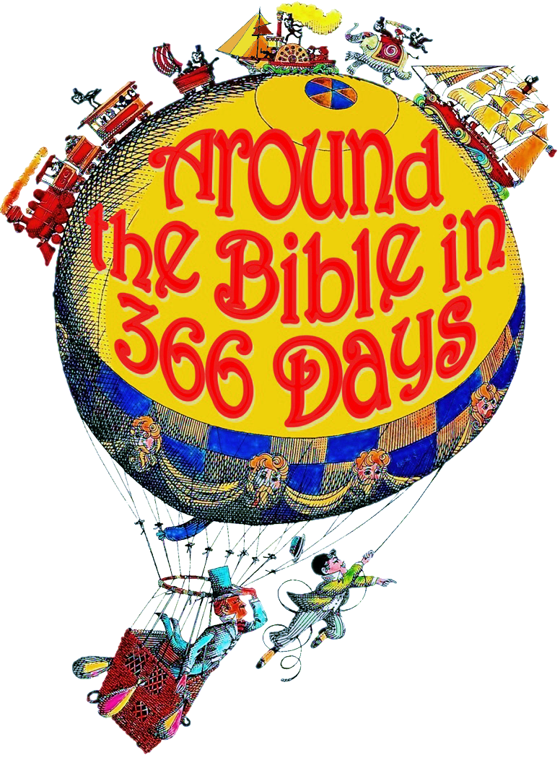
Hardships (Acts 14:8-22)
Week 47

Slide 3
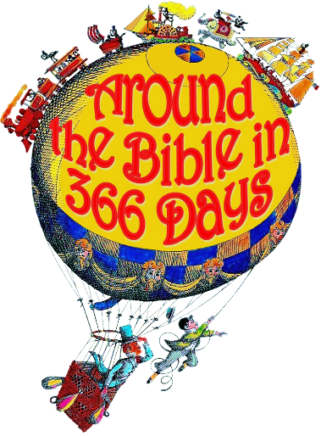
Acts 14:8-22
²¹ They preached the gospel in that city and won a large number of disciples. Then they returned to Lystra, Iconium and Antioch, ²² strengthening the disciples and encouraging them to remain true to the faith. “We must go through *many hardships to enter the kingdom of God,” they said.
*many- (pollon) expresses not merely quantity or number but variety

Slide 4
Hardships are prerequisites
1 Peter 4:12-13
¹² Dear friends, do not be surprised at the fiery ordeal that has come on you to test you, as though something strange were happening to you. ¹³ But rejoice inasmuch as you participate in the sufferings of Christ, so that you may be overjoyed when his glory is revealed.

Slide 5
Hardships are prerequisites
Hardships we bring on ourselves require repentance
Hardships someone brings on us require forgiveness
Hardships that have no apparent cause require faith

Slide 6
God allows hardships for good and necessary reasons:
To prepare us to comfort others (ministry)
2 Corinthians 1:4-6 (NLT)
⁴ He comforts us in all our troubles so that we can comfort others. When they are troubled, we will be able to give them the same comfort God has given us. ⁵ For the more we suffer for Christ, the more God will shower us with his comfort through Christ.

Slide 7
God allows hardships for good and necessary reasons:
To prepare us to comfort others (ministry)
2 Corinthians 1:4-6 (NLT)
⁶ Even when we are weighed down with troubles, it is for your comfort and salvation! For when we ourselves are comforted, we will certainly comfort you. Then you can patiently endure the same things we suffer.

Slide 8
God allows hardships for good and necessary reasons:
To teach us to trust in Him and not in ourselves
2 Corinthians 1:9 (NLT)
In fact, we expected to die. But as a result, we stopped relying on ourselves and learned to rely only on God, who raises the dead.

Slide 9
God allows hardships for good and necessary reasons:
To turn our eyes from ourselves to God
James 5:13 (NLT) Are any of you suffering hardships? You should pray.
John 16:33 (NLT) “I have told you all this so that you may have peace in me. Here on earth you will have many trials and sorrows. But take heart, because I have overcome the world.”

Slide 10
God allows hardships for good and necessary reasons:
To develop maturity
James 1:2-4, 12 (NIV)
² Consider it pure joy, my brothers and sisters, whenever you face trials of many kinds, ³ because you know that the testing of your faith produces perseverance. ⁴ Let perseverance finish its work so that you may be mature and complete, not lacking anything….

Slide 11
God allows hardships for good and necessary reasons:
To develop maturity
James 1:2-4, 12 (NIV)
¹² Blessed is the one who *perseveres under trial because, having stood the test, that person will receive the crown of life that the Lord has promised to those who love him.
*Perseveres: “to remain under”

Slide 12
God allows hardships for good and necessary reasons:
Acts 14:22
…strengthening the disciples and encouraging them to remain true to the faith. “We must go through many hardships to enter the kingdom of God,” they said.
God will do something through you when you first allow him to do something in you

