Slide 2


Slide 3
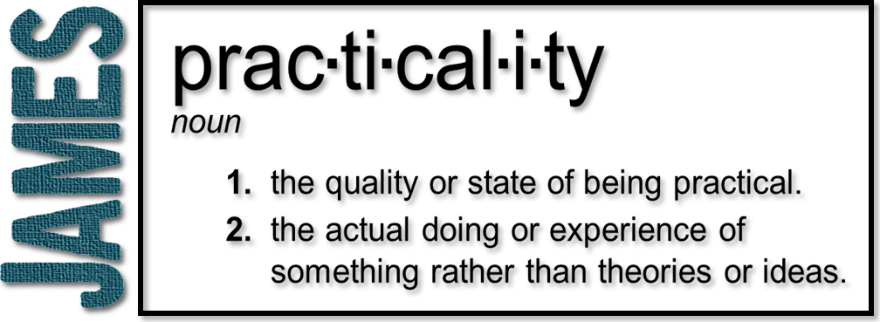
Week 5: Favoritism
(James 2:1-13)

Slide 4

Vs. 1
Be like Jesus!

Slide 5
1 Samuel 16:7
Vs. 1
But the Lord said to Samuel, “Do not consider his appearance or his height, for I have rejected him. The Lord does not look at the things people look at. People look at the outward appearance, but the Lord looks at the heart.”

Slide 6
Acts 10:34-35
Vs. 1
³⁴ Then Peter began to speak: “I
now realize how true it is that God does not show favoritism ³⁵ but accepts from every nation the one who fears him and does what is right.
Based on who Jesus is; don’t
show favoritism!

Slide 7
Favoritism
Vs. 1
Vs. 2-4
    The practice of giving unfair
    preferential treatment to one person or group at the expense of another
Partiality; discrimination; prejudice; inequality; bias
Rich/poor economic divide (social status)
Jew/Gentile; slave/free

Slide 8
Favoritism
Vs. 2-4
    Embracing certain expectations
    based on various markers and shunning anything else…
What is and isn’t worship
What constitutes preaching/teaching
What is and isn’t the manifestation of the gifts of the Spirit

Slide 9
Favoritism
Vs. 2-4
      Racism
      Gender inequality
      Cliques
      James’ example is that of visitors
A significant aspect of the work of Jesus was to break down these walls that divided humanity

Slide 10
The Poor
Vs. 5-7
Proverbs 14:31
He who oppresses the poor shows
contempt for their Maker, but whoever is kind to the needy honors God.
In the Roman world the poor were faceless nothings in the eyes of the wealthy

Slide 11
The Poor
Vs. 5-7
    Materially and spiritually
Matthew 5:3
“Blessed are the poor in spirit, for theirs is the kingdom of heaven.”
The rich man may trust Him; but the poor man must

Slide 12
Our Neighbor
Vs. 8-11
Vs. 5-7
    To love your neighbor as yourself
    is tied to loving God
Christians cannot pick and choose who is to be their neighbor or when they are to follow this law
Favoritism is sin
James guards us against a selective obedience

Slide 13
Vs. 8-11
Vs. 12-13
Mercy

