Slide 2


Slide 3

Ephesus
Acts 19:1-20 The church was born out of an incredible move of God
Paul, Timothy, and John himself
Most likely the mother church of the other 6 churches

Slide 4
Week 5:
First Love
(Revelation 2:1-7)

Slide 5
#1 Specific aspect of the revelation
of Jesus for Ephesus
He is walking among them/
He is with them
He is in control
The Church is His greatest concern
He is active

Slide 6
#2 True condition
(I know…”)
Nothing is hidden
Even if they don’t know
Clarity

Slide 7

#3 Commendation
Deeds, hard work, perseverance
Intolerant of sin & wicked men
Discernment
Sound, unwavering doctrine
Remained faithful
Have not grown weary

Slide 8
#4 Correction
Forsaken/ left/ abandoned
their first love
Passion and fervor becoming
just cold function
Doing duty only/ going through the motions
No zeal, no joy, no life

Slide 9
Importance of our love for the Lord
The great commandment
Matthew 10:37-38
³⁷ “Anyone who loves their father or mother more than me is not worthy of
me; anyone who loves their son or daughter more than me is not worthy of me. ³⁸ Whoever does not take up their cross and follow me is not worthy of me.”

Slide 10
Importance of our love for the Lord
What did Jesus ask Peter three times to determine his spiritual condition?
2 Corinthians 5:14 (NRSV)
For the love of Christ urges us on, because we are convinced that one has died for all; therefore all have died.
The love of Christ constrains us, compels us, controls us, rules us

Slide 11
#4 Correction
Love for people
Had the holding onto truth part but lost love
It was to the Ephesians that Paul wrote: “Speak the truth in love” (Ephesians 4:15)

Slide 12
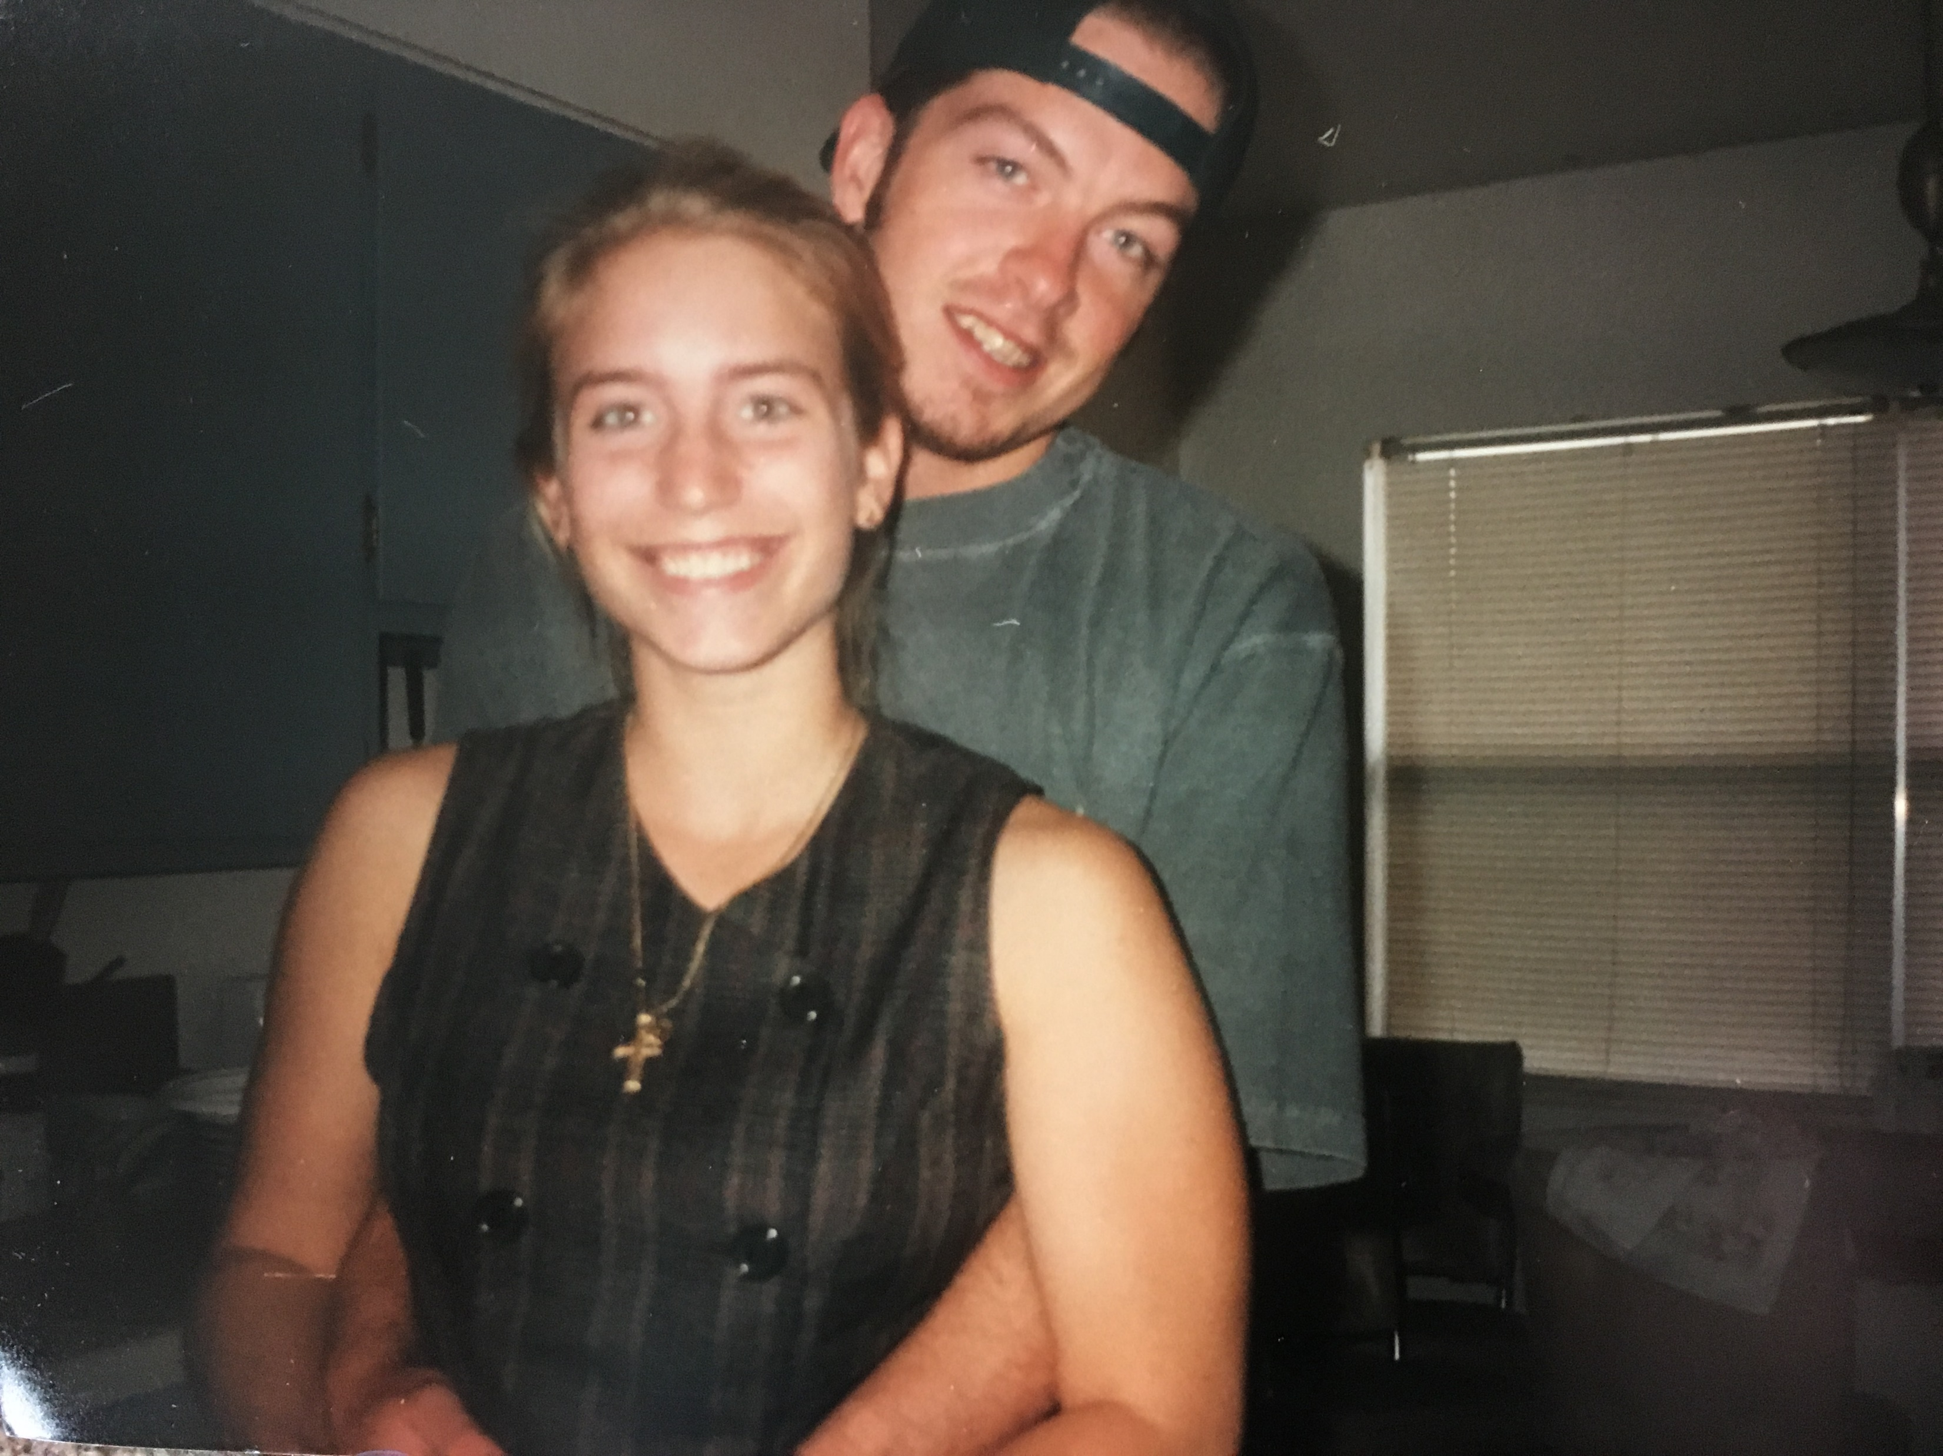
#5 Encouragement
Remember
Revelation 12:11 (NASB)
And they overcame him because of the blood of the Lamb and because of the word of their testimony, and they did not love their life even when faced with death.

Slide 13
#5 Encouragement
Remember
Repent!
Repeat
Or else… Removal
At least they haven’t compromised/ went after other loves

Slide 14
#6 Listen up!
“He who has an ear”
The Spirit says this
#7 His promise
“To him who overcomes”
The right to eat- from tree of life
The paradise of God

Slide 15
Remember
Repent
Repeat

