Slide 3
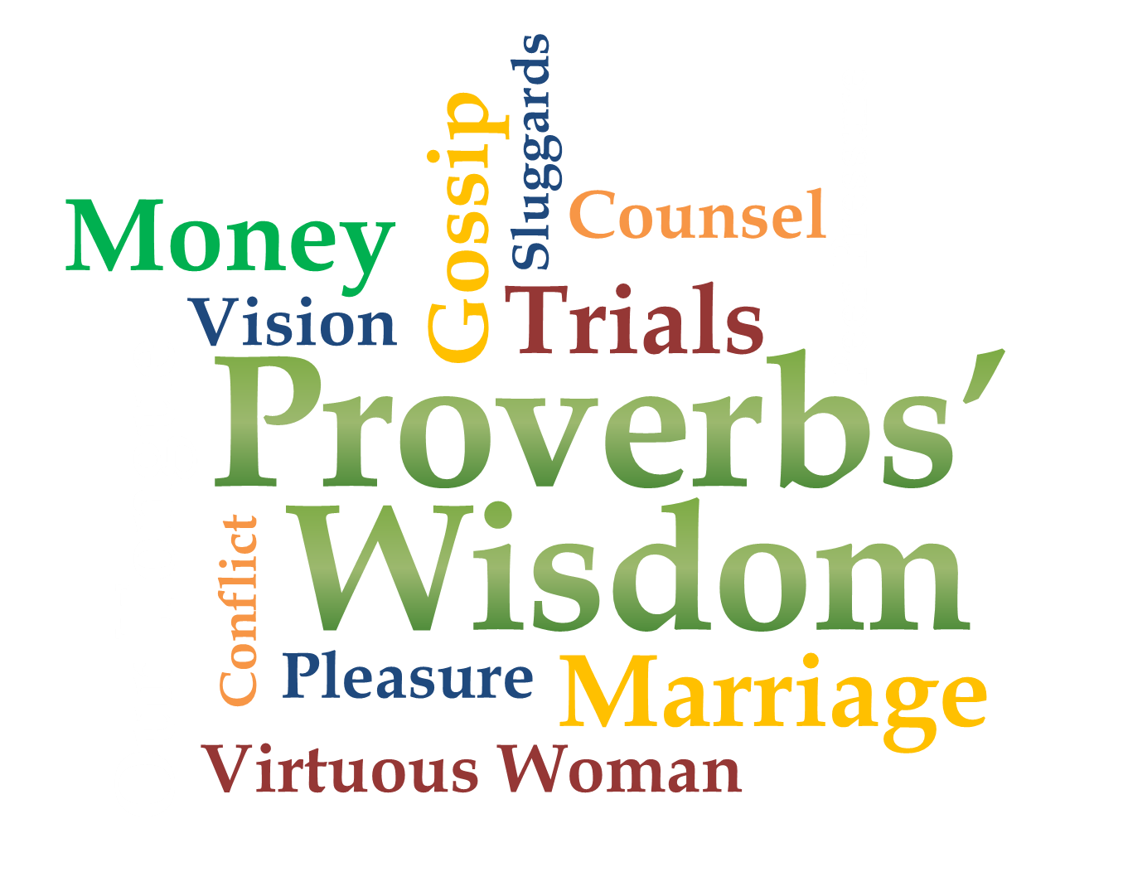
Week 5
Gossip

Slide 4
Gossip is so appealing!
Proverbs 18:8
The words of a gossip are like choice morsels; they go down to a man's inmost parts.
Proverbs 12:23
A prudent man keeps his knowledge to himself, but the heart of fools blurts out folly.

Slide 5
What is Gossip?
Simply talking about someone who is not present is not necessarily sinful
Jesus talked about John the Baptist
(Matt 11:7-19)
Peter told about Cornelius’ conversion
(Acts 11:1-18)

Slide 6
What is Gossip?
Telling unfavorable things about people not present is not always necessarily sinful
Jesus warned His disciples about errors of the Pharisees
(Matt 16:5-12)
Paul warned Timothy of specific men who teach incorrect doctrine
(2 Tim 2:16-18)

Slide 7
What is Gossip?
Morsels of Gossip:
Rumor- Unverified information of uncertain origin usually spread by word of mouth; hearsay
Slander- Defamatory statements that injure the reputation or thoughts about another person. A malicious statement or report

Slide 8
What is Gossip?
Proverbs 10:18-21
¹⁸ He who conceals his hatred has lying lips, and whoever spreads slander is a fool. ¹⁹ When words are many, sin is not absent, but he who holds his tongue is wise. ²⁰ The tongue of the righteous is choice silver, but the heart of the wicked is of little value. ²¹ The lips of the righteous nourish many, but fools die for lack of judgment.

Slide 9
What is Gossip?
Matthew 18:15-18
Step 1: Person to person (directly)
Step 2: Person to person with one or two others
Step 3: Church leader participation
Step 4: Release from relationship
The goal is reconciliation

Slide 10
What is Gossip?
Morsels of Gossip:
Innuendo- subtle insinuations that can mislead others into thinking wrong thoughts or to jump to wrong conclusions
Proverbs 26:20
Without wood a fire goes out; without gossip (or where there is no whisperer) a quarrel dies down.

Slide 11
What is Gossip?
Morsels of Gossip:
Mocking- to ridicule, criticize, or scorn someone or something. Many times to make yourself, your performance or group look better to others
Proverbs 21:24 (NLT)
Mockers are proud and haughty; they act with boundless arrogance.

Slide 12
What is Gossip?
Proverbs 15:12
Mockers resent correction, so they avoid the wise.
Psalms 1:1
Blessed is the man who does not walk in the counsel of the wicked or stand in the way of sinners or sit in the seat of mockers.

Slide 13
Gossip is damaging
Proverbs 16:27-28
²⁷ A scoundrel plots evil, and his speech is like a scorching fire. ²⁸ A perverse man stirs up dissension, and a gossip separates close friends.
Proverbs 25:9-10
⁹ If you argue your case with a neighbor, do not betray another man's confidence, ¹⁰ or he who hears it may shame you and you will never lose your bad reputation.

Slide 14
So what do we do about it?
Proverbs 20:19
A gossip betrays a confidence; so avoid a man who talks too much.
Proverbs 24:28-29
²⁸ Do not testify against your neighbor without cause, or use your lips to deceive. ²⁹ Do not say, “I'll do to him as he has done to me; I'll pay that man back for what he did.”

Slide 15
So what do we do about it?
Proverbs 11:9-13
⁹ With his mouth the godless destroys his neighbor, but through knowledge the righteous escape. ¹⁰ When the righteous prosper, the city rejoices; when the wicked perish, there are shouts of joy. ¹¹ Through the blessing of the upright a city is exalted, but by the mouth of the wicked it is destroyed…

Slide 16
So what do we do about it?
Proverbs 11:9-13
…¹² A man who lacks judgment derides his neighbor, but a man of understanding holds his tongue. ¹³ A gossip betrays a confidence, but a trustworthy man keeps a secret.

Slide 17
Our Prayer for Gossip
May our desire for morsels cease
Give us better judgment and understanding
Help us to be better friends; to not betray confidence
Check our motives
Help us to avoid those who talk too much
May we honor You

