Slide 2



Slide 3
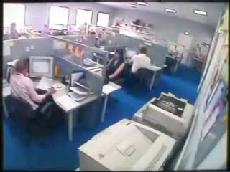

Slide 4
Week Five- I Am So Angry!

Slide 5

Jonah chapter 4

Slide 6
Pride

Slide 7
Inconvenience

Slide 8
Uncomfortability

Slide 9
“What is all discontent, but anger with God?”
–Adam Clarke

Slide 10
Entitlement

Slide 11
Offense/Hurt

Slide 12
Anger
²⁶ “In your anger do not sin”: Do not let the sun go down while you are still angry, ²⁷ and do not give the devil a foothold.
(Ephesians 4:26-27)

Slide 13
Anger
Becomes sin:
when we allow anger to control us
“For every minute you remain angry, you give up sixty seconds of peace of mind.”
-Ralph Waldo Emerson

Slide 14
Anger
Becomes sin:
when we allow anger to control us
in our expression of anger

Slide 15
Anger
¹⁹ My dear brothers, take note of this: Everyone should be quick to listen, slow to speak and slow to become angry, ²⁰ for man's anger does not bring about the righteous life that God desires.
(James 1:19-20)

Slide 16
Anger
A fool gives full vent to his anger, but a wise man keeps himself under control.
(Proverbs 29:11)

Slide 17
Anger
A hot-tempered man must pay the penalty; if you rescue him, you will have to do it again.
(Proverbs 19:19)

Slide 18
Our God of Second Chances!

