Slide 2
DESPERATE

Slide 3
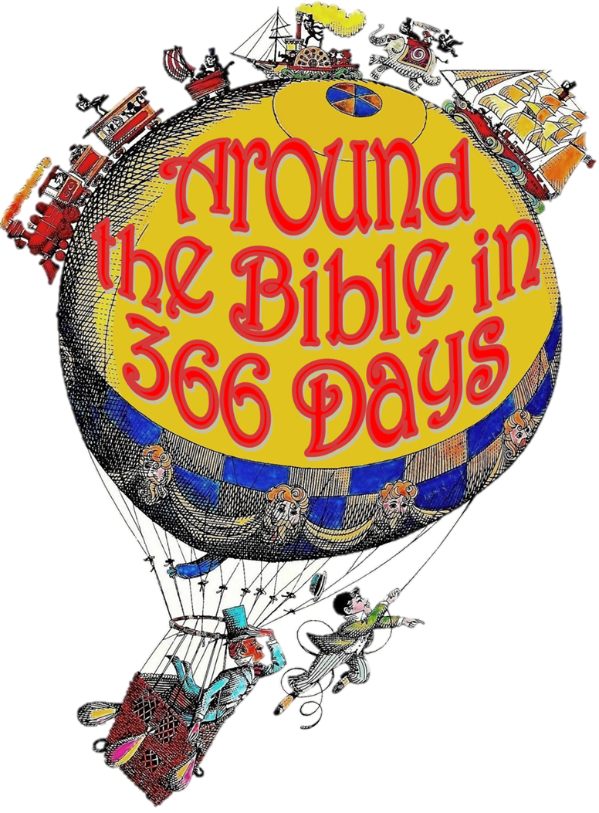
Week 5:
I Must Have HIS Presence!
(Exodus 33)

Slide 4
HE would not go with them

Slide 5
They had taken God’s presence for granted

Slide 6
There is extraordinary intimacy in
His presence

Slide 7
Knowledge, favor, and rest are in His presence

Slide 8
God’s presence is vital!
We shouldn’t budge an inch on our own

Slide 9
Psalm 16:11
You make known to me the path of life; in your presence there is fullness of joy; at your right hand are pleasures forevermore.

Slide 10
We are distinguished by His presence

Slide 11
Moses sought one further thing: God's glory!

Slide 12
I Must Have HIS Presence!

