Slide 2
Week 5: Power to Be Repurposed

Slide 3
→ Luke 5:33-38
Being a disciple of Jesus means, you do things differently
“How can you do religious tradition when I am with you?!”
“How can you _________________ when I am with you?!”

Slide 4
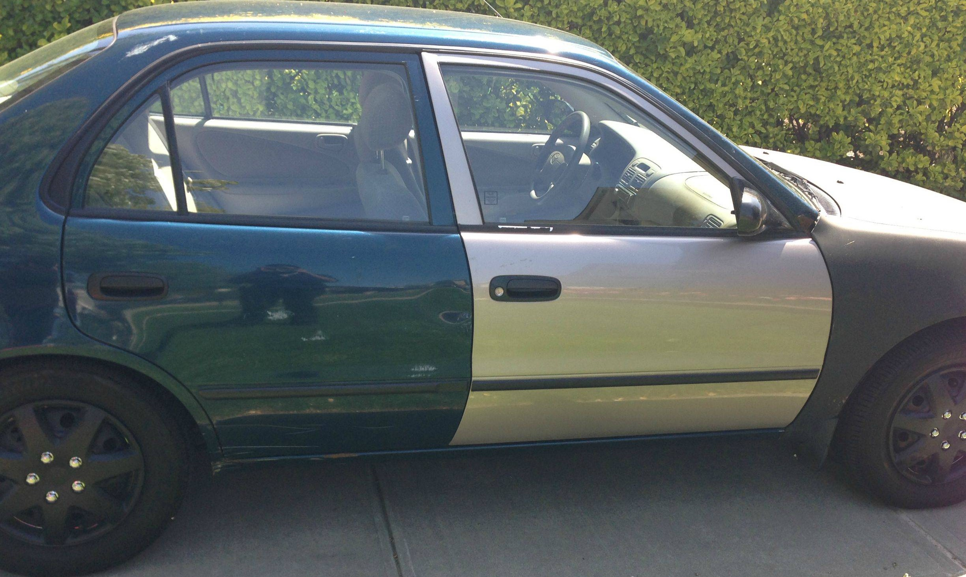
→ Luke 5:33-38
Patchwork is useless!

Slide 5
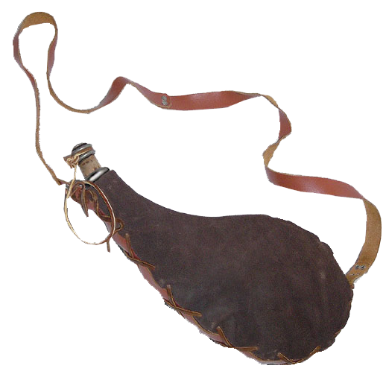
→ Luke 5:33-38
Patchwork is useless!
New wine = New Covenant
- is the receipt of the Holy Spirit
Wineskin = type of vessel (old or new)
New wine is not for old wineskins
It will not hold it!

Slide 6
→ Luke 5:33-38
The old wine seems more gratifying to the senses
It is only in abstaining from the old wine that the new wine can be poured out

Slide 7
The Holy Spirit gives us power to be repurposed!
Peter in Acts 2
Saul/Paul in Acts 9

Slide 8
Acts 9:17-22
¹⁷ Then Ananias went to the house and entered it. Placing his hands on Saul, he said, “Brother Saul, the Lord—Jesus, who appeared to you on the road as you were coming here—has sent me so that you may see again and be filled with the Holy Spirit.” ¹⁸ Immediately, something like scales fell from Saul’s eyes, and he could see again. He got up and was baptized…

Slide 9
Acts 9:17-22
²⁰ At once he began to preach in the synagogues that Jesus is the Son of God. ²¹ All those who heard him were astonished and asked, “Isn’t he the man who raised havoc in Jerusalem among those who call on this name? And hasn’t he come here to take them as prisoners to the chief priests?” ²² Yet Saul grew more and more powerful and baffled the Jews living in Damascus by proving that Jesus is the Christ.

Slide 10
The New Wineskin
“Paul, a servant of Christ Jesus, called to be an apostle and set apart for the gospel of God” (Romans 1:1)
“Simon Peter, a servant and apostle of Jesus Christ…” (2 Peter 1:1)
“James, a servant of God and of the Lord Jesus Christ…” (James 1:1)
“Jude, a servant of Jesus Christ and a brother of James…” (Jude 1:1)
He made it known by sending his angel to his servant, John (Revelation 1:1)

Slide 11
The New Wineskin
“Paul, a doulos of Christ Jesus, called to be an apostle and set apart for the gospel of God” (Romans 1:1)
“Simon Peter, a doulos and apostle of Jesus Christ…” (2 Peter 1:1)
“James, a doulos of God and of the Lord Jesus Christ…” (James 1:1)
“Jude, a doulos of Jesus Christ and a brother of James…” (Jude 1:1)
He made it known by sending his angel to his doulos, John (Revelation 1:1)

Slide 12
The New Wineskin
Doulos- A bond-servant, a slave who says “I love my master and do not want to leave you” voluntarily giving up freedom to walk away
One who is devoted to their master to the disregard of their own interests

Slide 13
The New Wineskin
Galatians 1:10 Am I now trying to win the approval of men, or of God? Or am I trying to please men? If I were still trying to please men, I would not be a doulos of Christ.

Slide 14
Ephesians 2:8-10
⁸ For it is by grace you have been saved, through faith—and this is not from yourselves, it is the gift of God— ⁹ not by works, so that no one can boast. ¹⁰ For we are God’s handiwork, created in Christ Jesus to do good works, which God prepared in advance for us to do.

