Slide 2
Jesus had to die

Slide 3
HIS Grace, HIS Mercy, HIS Love, HIS Plan. HIS Power. Where then is our boasting?
His HEAD was wounded, that our minds might be renewed and think like He does.
His HEART was bruised and crushed, that ours might be whole and wholly His.
His HANDS were pierced, that we might have stamped on ours, "Belonging to the Lord".
His HEELS dug into the cross, that we might be lifted up and be able to breathe fresh air.

Slide 4
His HONOR was laid low, that we might be honorable people.
His HEALTH failed unto death, that we might be alive and healthy.
His HAPPINESS was complete at death, because He saw us hid within himself, a gift unto God the Father.
His HEAVEN became a reality, for He recreated us in His image.
--Jerry Francis

Slide 5
Jesus had to be resurrected

Slide 6
1 Corinthians 15:12-22 (NIV)
¹² But if it is preached that Christ has been raised from the dead, how can some of you say that there is no resurrection of the dead? ¹³ If there is no resurrection of the dead, then not even Christ has been raised. ¹⁴ And if Christ has not been raised, our preaching is useless and so is your faith. ¹⁵ More than that, we are then found to be false witnesses about God, for we have testified about God that he raised Christ from the dead… ¹⁷ And if Christ has not been raised, your faith is futile; you are still in your sins.

Slide 7
1 Corinthians 15:12-22 (NIV)
¹⁸ Then those also who have fallen asleep in Christ are lost. ¹⁹ If only for this life we have hope in Christ, we are of all people most to be pitied.
²⁰ But Christ has indeed been raised from the dead, the firstfruits of those who have fallen asleep. ²¹ For since death came through a man, the resurrection of the dead comes also through a man. ²² For as in Adam all die, so in Christ all will be made alive.

Slide 8
ALIVE!
JOHN 20:1-18

Slide 9
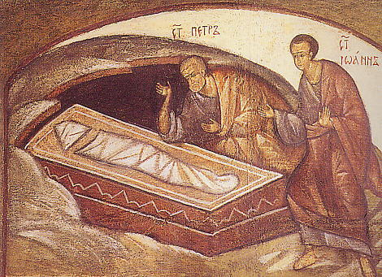

Slide 10
“But God raised Him from the dead, freeing him from the agony of death, because it was impossible for death to keep its hold on Him.” (Acts 2:24)

Slide 11
There’s Something About Mary

Slide 12
She loved much because she was grateful for her new life
She waited
She was desperate
She recognized Jesus when He spoke her name
She grabbed ahold of Jesus and wouldn’t let go
She was the first to share the news “I have seen the Lord.”

Slide 13
She experienced Jesus alive!

Slide 14
Romans 8:9-11 (MSG)
⁹⁻¹¹ But if God himself has taken up residence in your life, you can hardly be thinking more of yourself than of him. Anyone, of course, who has not welcomed this invisible but clearly present God, the Spirit of Christ, won’t know what we’re talking about. But for you who welcome him, in whom he dwells—even though you still experience all the limitations of sin—you yourself experience life on God’s terms.

Slide 15
Romans 8:9-11 (MSG)
It stands to reason, doesn’t it, that if the alive-and-present God who raised Jesus from the dead moves into your life, he’ll do the same thing in you that he did in Jesus, bringing you alive to himself? When God lives and breathes in you (and he does, as surely as he did in Jesus), you are delivered from that dead life. With his Spirit living in you, your body will be as alive as Christ’s!

