Slide 3
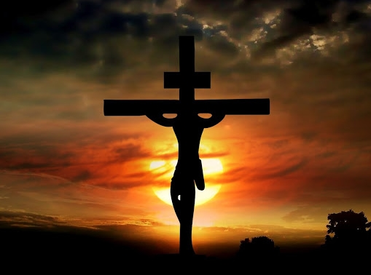
Isaiah 53
Over 700 years BEFORE
Jesus Christ was born!
Written c. 700 BC

Slide 4
Week Five: Prophecies of Jesus in the Old Testament

Slide 5
What is Prophecy?
Miracle of knowledge, a declaration or description of representation of something future, beyond the power of human sagacity to foresee, discern or conjecture.

Slide 6
Foretelling vs. Forth-telling
Foretelling: Predictions of future events
Forth-Telling: Declaration of a message from God to others

Slide 7
Isaiah 46:9-10
Remember the former things long past, for I am God, and there is no other: I am God, and there is no one like Me, declaring the end from the beginning, and from ancient times things which have not been done, saying, ‘My purpose will be established, and I will accomplish all my good pleasure.’

Slide 8
Messianic Prophecy #1 Born in Bethlehem
Micah 5:2 – “But you, O Bethlehem Ephrathah, are only a small village among all the people of Judah. Yet a ruler of Israel will come from you, one whose origins are from the distant past.”

Slide 9
Messianic Prophecy #2 Born of a Virgin
Isaiah 7:14 – “…the Lord himself will give you the sign. Look! The virgin will conceive a child! She will give birth to a son and will call him Immanuel.”

Slide 10
Messianic Prophecy #3 Killed Together with Criminals
Isaiah 53:12 – “Because He poured out Himself to death, and was numbered with the transgressors, Yet He Himself bore the sin of many, and interceded for the transgressors.”

Slide 11
Messianic Prophecy #4 His Side would be Pierced
Zechariah 12:10 – “…the Spirit of grace and of supplication, so that they will look on Me whom they have pierced; and they will mourn for Him, as one mourns for an only son, and they will weep bitterly over Him like the bitter weeping over a firstborn.”

Slide 12
OT Books Timeline Perspective
Micah
737-696 BC
Zechariah
480-479 BC
Jesus Christ
0 – 32-33 AD
600 BC
500 BC
400 BC
300 BC
200 BC
100 BC
100 AD
Isaiah
700-681 BC
128 BC
DEAD SEA SCROLLS
Dates given to the scrolls of Micah, Zechariah and Isaiah found at Qumran.

Slide 13
Mathematical View of Messianic Prophecies
Dr. Peter Stoner – Professor Emeritus of Science at Westmont College
The Chance of one man fulfilling only 8 of the more than 300 Messianic Prophecies is 1:10 (17th Power)
OR
1 in 100,000,000,000,000,000

Slide 14
Matthew 26:56
“But all this has taken place that the Scriptures of the prophets may be fulfilled.”

Slide 15
Luke 24:25-27
He said to them, “O foolish men and slow of heart to believe in all that the prophets have spoken! Was it not necessary for the Christ to suffer these things and to enter into His glory?” And beginning with Moses and with all the prophets, He explained to them the things concerning Himself in all the Scriptures.

