Slide 3
James 2:14-26

Slide 4
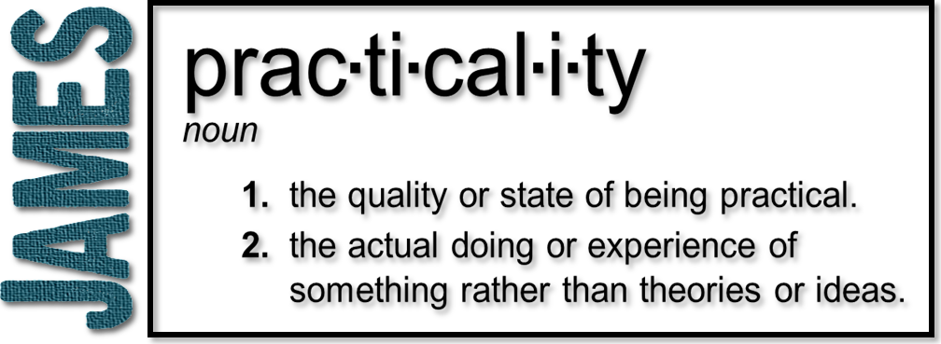
Week 6: Walk that Walk
(James 2:14-26)

Slide 5
The Big Idea
James 2:14 – “What use is it brethren, if someone says he has faith, but he has no works.”
Addressing a problem James saw in believers within the church: No evidence of true and genuine faith in their lives!
:17 – Even so faith, if it has no works, is dead, being by itself
Two Types of Faith
One with works (living and genuine)
One without works (dead)

Slide 6
What is Faith
Hebrews 11:1 – Now faith is the assurance of things hoped for, the conviction of things not seen.
Hebrews 11:6 – And without faith it is impossible to please Him, for he who comes to God must believe that He is and that He is a rewarder of those who seek him.
Characteristics of Genuine Faith
Belief in God
Trust in God
Obedience to God
Endurance

Slide 7
Evidence of Faith
James 2:14 –What use is it, my brethren, if someone says he has faith but he has no works?
WORKS = Actions taken BECAUSE of one’s faith that demonstrate an authentic faith.
Works are not ADDED to faith; a genuine faith INCLUDES works.
James states that faith without works…
…is of no use (vs. 14,16)
…does not save (vs. 14)
…is dead! (vs. 17)

Slide 8
Do Paul and James Contradict?
Ephesians 2:8-9 For it is by grace you have been saved through faith; and that not of yourselves, it is the gift of God; not a result of works, so that no one may boast.
Works are not bad – they just can’t save you!
Paul’s Focus: Gentile believers being influenced by Judaizers (Jews who has converted to Christianity) telling them they had to keep the OT law to be justified. WORKS TO KEEP THE LAW – TO BE JUSTIFIED
James’ Focus: Believers not displaying the characteristics of genuine faith by not keeping the moral law of Christ (love your neighbor as yourself). WORKS AS EVIDENCE OF TRUE FAITH

Slide 9
True Faith & Works Inseparable
:20-24 – Actions of faithful people
- Believed what God said
- Abraham – sacrificing Isaac
A supreme act of obedience carried out in faith. Genuine faith results in actions/works
:24 – So you see, we are shown to be right with God by what we do, not by faith alone (New Living Translation)
Works DO NOT justify us… however they MUST be evident in the life of a believer who has genuine faith.

Slide 10
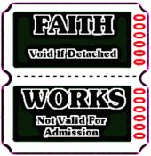
Works
Endurance
Belief
Genuine Faith
Trust

Slide 11
1 Corinthians 13:5
Examine yourselves to see if your faith is genuine. Test yourselves. Surely you know that Jesus Christ is among you; if not, you have failed the test of genuine faith.
New Living Translation

Slide 12
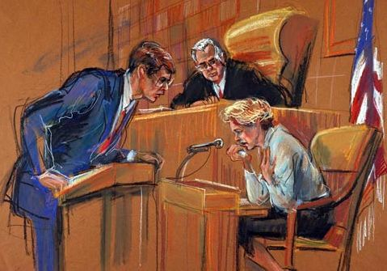
What if Our Faith was on Trial?
- Believe in God
Works DO NOT justify us… however they MUST be evident in the life of a believer who has genuine faith.

Slide 13
Matthew 7:21-23
Not everyone who says to me Lord, Lord will enter the kingdom of heaven, but he who does the will of my father who is in heaven. Many will say to me on that date, Lord, Lord, did we not prophesy in your name and in your name cast out demons, and in your name performed many miracles? And then I will declare to them, I never knew you, depart from me you who practice lawlessness.
The problem was not their good works…
The problem was their good works did not flow out of a genuine faith but rather out of a works-based belief system that by-passed grace and faith.

Slide 14
John 14:10b-12
The words that I say to you I do not speak on My own initiative, but the Father abiding in Me does His works. Believe Me that I am in the Father and the Father is in Me; otherwise believe because of the works themselves. Truly, truly I say to you, he who believes in Me, the works that I do, he will do also; and greater works than these he will do; because I go to the Father.

