Slide 2
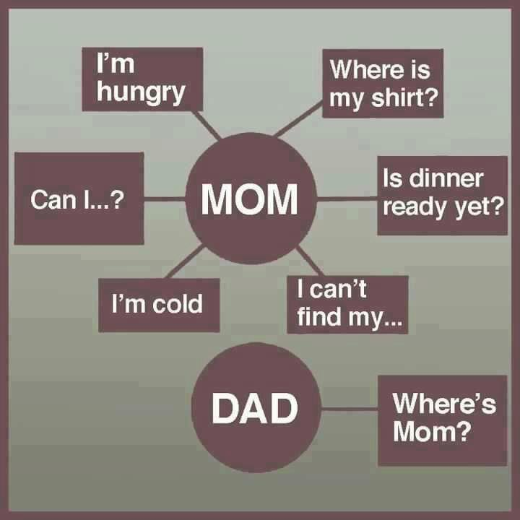

Slide 4
That’s None of Your Business!
JOHN 21:18-25

Slide 5
The “That Isn’t Fair!”
Distraction

Slide 6
Matthew 5:38-48
³⁸ “You have heard that it was said, ‘Eye for eye, and tooth for tooth.’ ³⁹ But I tell you, do not resist an evil person. If anyone slaps you on the right cheek, turn to them the other cheek also. ⁴⁰ And if anyone wants to sue you and take your shirt, hand over your coat as well. ⁴¹ If anyone forces you to go one mile, go with them two miles. ⁴² Give to the one who asks you, and do not turn away from the one who wants to borrow from you.

Slide 7
Matthew 5:38-48
⁴³ “You have heard that it was said, ‘Love your neighbor and hate your enemy.’ ⁴⁴ But I tell you, love your enemies and pray for those who persecute you… ⁴⁶ If you love those who love you, what reward will you get? Are not even the tax collectors doing that? ⁴⁷ And if you greet only your own people, what are you doing more than others? Do not even pagans do that? ⁴⁸ Be perfect, therefore, as your heavenly Father is perfect.

Slide 8
The Competition
Distraction

Slide 9
Mark 10:35-45
³⁵ Then James and John, the sons of Zebedee, came to him. “Teacher,” they said, “we want you to do for us whatever we ask.” ³⁶ “What do you want me to do for you?” he asked. ³⁷ They replied, “Let one of us sit at your right and the other at your left in your glory.” ³⁸ “You don’t know what you are asking,” Jesus said. “Can you drink the cup I drink or be baptized with the baptism I am baptized with?”

Slide 10
Mark 10:35-45
³⁹ “We can,” they answered. Jesus said to them, “You will drink the cup I drink and be baptized with the baptism I am baptized with, ⁴⁰ but to sit at my right or left is not for me to grant. These places belong to those for whom they have been prepared.” ⁴¹ When the ten heard about this, they became indignant with James and John.

Slide 11
Mark 10:35-45
⁴² Jesus called them together and said, “You know that those who are regarded as rulers of the Gentiles lord it over them, and their high officials exercise authority over them. ⁴³ Not so with you. Instead, whoever wants to become great among you must be your servant, ⁴⁴ and whoever wants to be first must be slave of all. ⁴⁵ For even the Son of Man did not come to be served, but to serve, and to give his life as a ransom for many.”

Slide 12
The Fear of Man
Distraction

Slide 13
Proverbs 29:25 (The Message)
The fear of human opinion disables; trusting in God protects you from that.
Matthew 10:32-33
³² “Whoever acknowledges me before others, I will also acknowledge before my Father in heaven. ³³ But whoever disowns me before others, I will disown before my Father in heaven.

Slide 14
The “I Will, Only If They…”
Distraction

Slide 15
Colossians 3:23-24
²³ Whatever you do, work at it with all your heart, as working for the Lord, not for human masters, ²⁴ since you know that you will receive an inheritance from the Lord as a reward. It is the Lord Christ you are serving.

Slide 16
Ephesians 5:22-28
²² Wives, submit yourselves to your own husbands as you do to the Lord… ²⁴ Now as the church submits to Christ, so also wives should submit to their husbands in everything. ²⁵ Husbands, love your wives, just as Christ loved the church and gave himself up for her … ²⁸ In this same way, husbands ought to love their wives as their own bodies. He who loves his wife loves himself.

Slide 17
Romans 12:18
If it is possible, as far as it depends on you, live at peace with everyone.

Slide 18
Romans 12:11-12
¹¹ Never be lacking in zeal, but keep your spiritual fervor, serving the Lord. ¹² Be joyful in hope, patient in affliction, faithful in prayer.

Slide 19
“What is that to you?
You must follow Me.”

