Slide 3
Starting next week!

Slide 4
Week Seven: Jesus is the Sabbath

Slide 5
The Sabbath

Slide 6
Physical (Mental/Emotional)
Spiritual

Slide 7
John 5:1-10

Slide 8
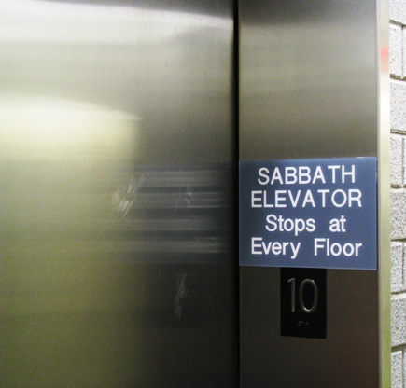

Slide 9
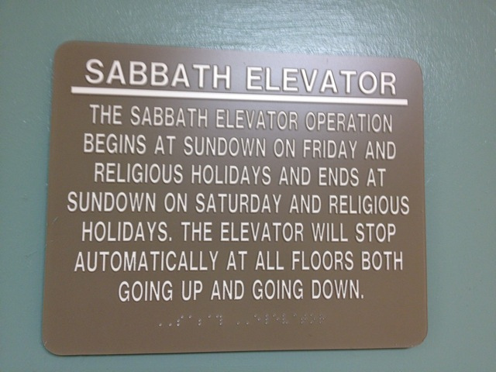

Slide 10
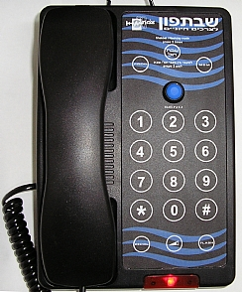

Slide 11
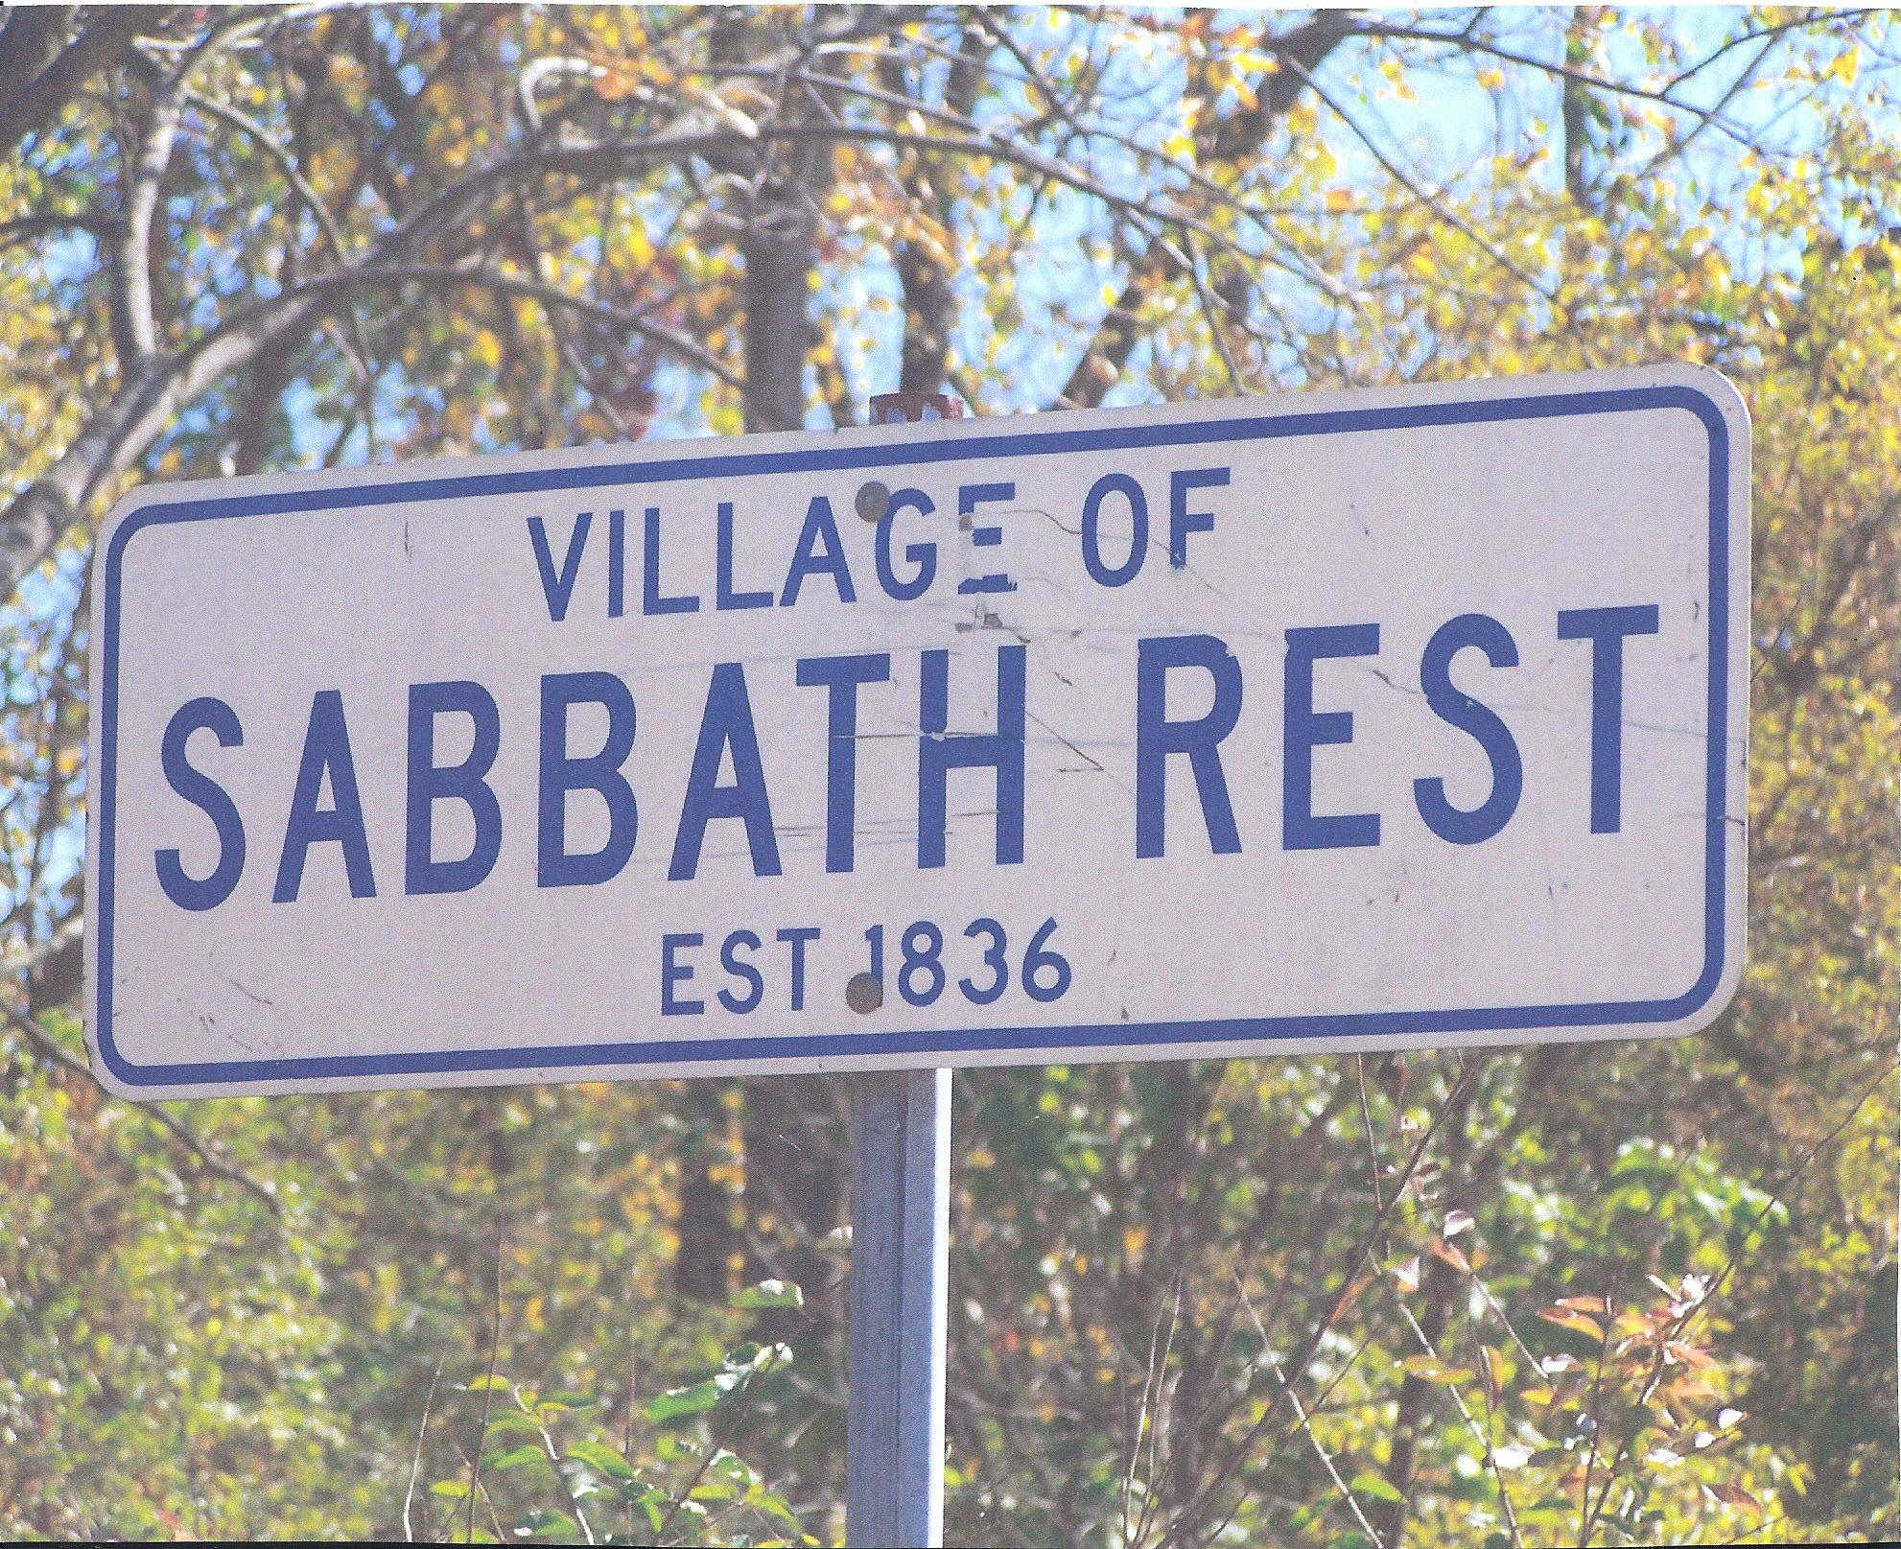

Slide 12
Exodus 31:13
“Say to the Israelites, ‘You must observe my Sabbaths. This will be a sign between me and you for the generations to come, so you may know that I am the LORD, who makes you holy.

Slide 13
Colossians 2:13-17
¹³ When you were dead in your sins and in the uncircumcision of your sinful nature, God made you alive with Christ. He forgave us all our sins, ¹⁴ having canceled the written code, with its regulations, that was against us and that stood opposed to us;

Slide 14
Colossians 2:13-17
¹⁵ And having disarmed the powers and authorities, he made a public spectacle of them, triumphing over them by the cross. ¹⁶ Therefore do not let anyone judge you by what you eat or drink, or with regard to a religious festival, a New Moon celebration or a Sabbath day.

Slide 15
Colossians 2:13-17
¹⁷ These are a shadow of the things that were to come; the reality, however, is found in Christ.

Slide 16
Matthew 5:17
“Do not think that I have come to abolish the Law or the Prophets; I have not come to abolish them but to fulfill them.” (To embody them and give them their true meaning)

Slide 17
John 5:11-19

Slide 18
Jesus is always at work; giving us rest!

Slide 19
Romans 4:4-5
⁴ Now to the one who works, wages are not credited as a gift but as an obligation. ⁵ However, to the one who does not work but trusts God who justifies the ungodly, their faith is credited as righteousness.

Slide 20
Matthew 11:28-30 (NIV)
²⁸ “Come to me, all you who are weary and burdened, and I will give you rest. ²⁹ Take my yoke upon you and learn from me, for I am gentle and humble in heart, and you will find rest for your souls. ³⁰ For my yoke is easy and my burden is light.”

Slide 21
Matthew 11:28-30 (MSG)
“Are you tired? Worn out? Burned out on religion? Come to me. Get away with me and you'll recover your life. I'll show you how to take a real rest.

Slide 22
Matthew 11:28-30 (MSG)
Walk with me and work with me—watch how I do it. Learn the unforced rhythms of grace. I won't lay anything heavy or ill-fitting on you. Keep company with me and you'll learn to live freely and lightly.”

