Slide 1
Conversations With John
The Four Calls of Discipleship

Slide 2
Mark 1:14-20
2) “Follow Me”

Slide 3
John 1:35-42
1) “Come and see”

Slide 4
1) “Come and see”
As a disciple-maker, John the baptist pointed beyond himself to Jesus
John and Andrew were searching
Jesus initiated. He always initiates!
Jesus asked the most fundamental question in life: “What do you want?”
Response: “What are you like?”

Slide 5
1) “Come and see”
“FIGHT!”

Slide 6
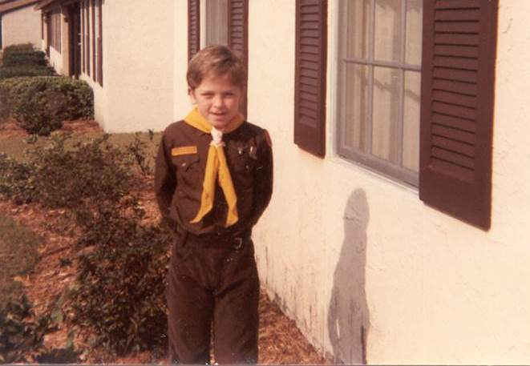
1) “Come and see”
“You would like this”

Slide 7
1) “Come and see”
They spent time with Jesus before committing
Andrew (Simon Peter’s brother)
Always introducing others to Jesus:
Brings Peter to Jesus (1:41-42)
Boy with two fish and five loaves (6:8-9)
Greeks who said “we’d like to see Jesus” (12:20-22)

Slide 8
1) “Come and see”
You are… you will be…

Slide 9
John 1:43-51
2) “Follow Me”

Slide 10
Four Calls of Discipleship
Investigation/Friendship
1)“Come and See” Jn 1:39 Being exposed to Jesus
2)“Follow Me” Jn 1:43; Mk 1:17 Walking w/ Jesus
3)“Be with Me” Mk 3:14
Significant time spent w/ Jesus
4)“Remain in Me” Jn 15:4 Being in Jesus & bearing fruit
Conviction
Attraction
Relationship
Commitment
Courting
Training
Character
Marriage
Identity
Competence
Children

Slide 11
George Barna revealed in a poll:
“A majority (55%) of adults who indicated their interest in hearing advice on how to improve their spiritual life also said that if the church matched them with a spiritual mentor or coach, they would be more likely to pursue changes suggested to them.”

Slide 12
proximity
produces
disciples.

