Slide 2
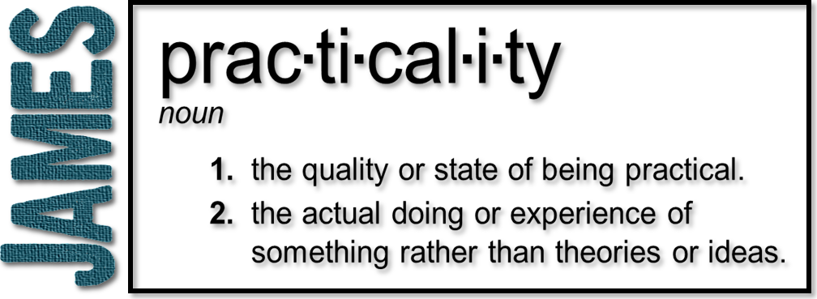
Week 7: The Power of Words
(James 3:1-12)

Slide 3
Five Illustrations
A teacher leading and directing people
Obligated to teach what is true and then to live up to what is taught
Matthew 12:36
“But I tell you that men will have to give account on the day of judgment for every careless word they have spoken.”

Slide 4
Vs. 2
We all stumble

Slide 5
Five Illustrations
A teacher leading and directing people
A bit in a horse’s mouth
If you control what you say, you can control the rest of what you do

Slide 6
Five Illustrations
A teacher leading and directing people
A bit in a horse’s mouth
A ship being steered by a very small rudder
Both images emphasize the power and accomplishment of something so small
Steering

Slide 7
Five Illustrations
A teacher leading and directing people
A bit in a horse’s mouth
A ship being steered by a very small rudder
A small spark sets a forest on fire
The sin of our speech spreads!
The tongue can unwittingly do the work of Satan

Slide 8
Five Illustrations
A teacher leading and directing people
A bit in a horse’s mouth
A ship being steered by a very small rudder
A small spark sets a forest on fire
The taming of a wild animal

Slide 9
Vs. 8
The tongue is full of deadly poison

Slide 10
Vs. 8
‘I lost a very little word, only the other day;
It was a very naughty word I had not meant to say.
But, then, it was not really lost—when from my lips it flew,
My little brother picked it up, and now he says it too!’

Slide 11
The Great Contradiction
Vs. 8
Vs 9-12
Ultimate impossibility
This. should. not. be.
The product shows the source!

Slide 12
Matthew 12:33-35 (NLT)
³³ “A tree is identified by its fruit. If a tree is good, its fruit will be good. If a tree is bad, its fruit will be bad. ³⁴ …For whatever is in your heart determines what you say. ³⁵ A good person produces good things from the treasury of a good heart, and an evil person produces evil things from the treasury of an evil heart.

Slide 13
Vs. 8
No man can tame the tongue!

Slide 14
The Role of the Holy Spirit
Isaiah’s commission
The Day of Pentecost
The Baptism of the Holy Spirit
Power to be His witnesses!
The gift of tongues
On our own, our tongue can do much damage. Controlled by the Holy Spirit, it can be a great blessing!

