Slide 2
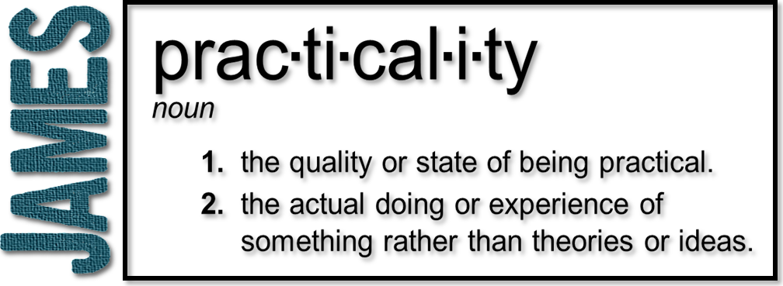
Week 8: Who Are You Listening To?
(James 3:13-18)

Slide 3
Wisdom
Knowledge
Raw information
Intelligence
Factual & Technical
Enables awareness
“What”
Wisdom
What to do with info
Insight
Applicable & Practical
Enables decisions
“How” and “Why”

Slide 4
Wisdom
Good life
1 Peter 1:15-16 ¹⁵ But just as he who called you is holy, so be holy in all you do; ¹⁶ for it is written: “Be holy, because I am holy.”
1 Peter 2:12 Live such good lives among the pagans that, though they accuse you of doing wrong, they may see your good deeds and glorify God on the day he visits us.

Slide 5
Wisdom
Good life
Deeds (Wisdom shows us how to do good works)
Humility (Comes from wisdom)

Slide 6
Wisdom
“Harboring bitter envy and selfish ambition”
Bitterness
Envy
Selfish ambition
Earthly
Unspiritual/Sensual

Slide 7
Jude 18-19
¹⁸ “In the last times there will be scoffers who will follow their own ungodly desires.” ¹⁹ These are the people who divide you, who follow mere natural instincts and do not have the Spirit.

Slide 8
Wisdom
“Harboring bitter envy and selfish ambition”
Bitterness
Envy
Selfish ambition
Earthly
Unspiritual/Sensual
Demonic

Slide 9
Wisdom
He gives a description instead of a definition:
Pure (unmixed, free from selfishness)
Peace-loving/ peace-making
A truly wise man will seek first purity in himself and then peace with others
Romans 12:18 If it is possible, as far as it depends on you, live at peace with everyone.

Slide 10
Wisdom
He gives a description instead of a definition:
Pure (unmixed, free from selfishness)
Peace-loving/ peace-making
Considerate
Submissive (willing to yield)

Slide 11
Wisdom
He gives a description instead of a definition:
Full of mercy (compassion drives action)
Full of good fruit
Impartial
Sincere (without hypocrisy)

Slide 13
Which wisdom is compelling us?
Who Are You Listening To?

