Slide 2
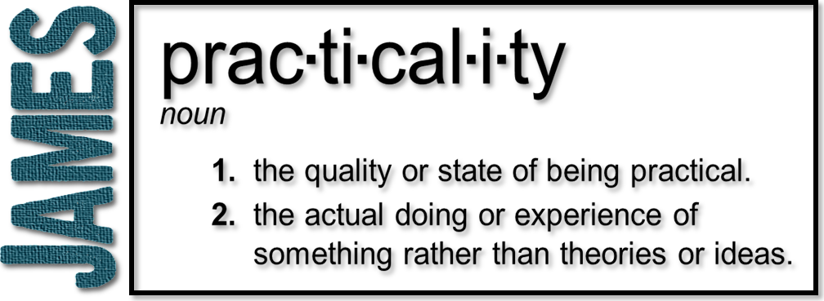
Week 9: Desires and Motives
(James 4:1-10)

Slide 3
Conflict
Galatians 5:17 (NLT)
The sinful nature wants to do evil, which is just the opposite of what the Spirit wants. And the Spirit gives us desires that are the opposite of what the sinful nature desires. These two forces are constantly fighting each other, so you are not free to carry out your good intentions.

Slide 4
Conflict
Desires (that battle within)
You want something but don’t get it
The natural heart of man is never content
Kill and covet!
Whenever lusts and pleasures rule the heart, conflicts and disputes will continue

Slide 5
Conflict
Motives (in our prayer life)
Prayerlessness
Praying amiss
selfish prayer
concerned with pleasures
The purpose of prayer is not to persuade a reluctant God to do our bidding; it is to align our will with His

Slide 6
Conflict
Friendship with the world
Spiritual adultery
Ezekiel 16:32 “You adulterous wife! You prefer strangers to your own husband!”
Polarizing!
God is jealous
The Spirit will convict the Christian who lives in compromise

Slide 7
The Solutions for Conflict
More grace!
By “grace” we are saved and by “more grace” we are sustained
Submit and draw near to God
He promises to draw near to us!

Slide 8
The Solutions for Conflict
Resist the devil
He promises the devil will flee from us!
Matthew 4:10-11
¹⁰ Jesus said to him, “Away from me, Satan! For it is written: ‘Worship the Lord your God, and serve him only.’” ¹¹ Then the devil left him, and angels came and attended him.

Slide 9
The Solutions for Conflict
Resist the devil
He promises the devil will flee from us!
Never try to withstand the enemy without submission to God
Whatever you do, never resist God and submit to the devil

Slide 10
The Solutions for Conflict
Deeply felt repentance
Inward and outward cleansing
Humble yourself (in the sight of the Lord)
Humility puts us in a position to receive
God will lift you up!

