Slide 1
Jesus Cleans House
John 2:13-22

Slide 2
How do you picture Jesus?

Slide 3
The Lion of the Tribe of Judah

Slide 4
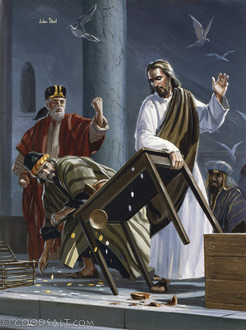

Slide 5
His disciples remembered that it is written: “Zeal for your house will consume me.”
John 2:17

Slide 6
ZEAL
Literal: Heat
Synonyms: enthusiasm, passion, zest, fire, spirit, devotion, fervor, eagerness, gusto, ardor, earnestness, fervency Antonyms: indifference, apathy, coolness, passivity, stoicism, unresponsiveness

Slide 7
Zeal for your house consumes me, and the insults of those who insult you fall on me. Psalms 69:9
Jesus was fulfilling OT prophecies and therefore his behavior was more than reactionary, it was prophetic.

Slide 8
Five Issues
Neglect of Prayer
Making the outer court of the temple into a market place
Making the temple into a “Den of Thieves”
Discrimination against the poor and
the foreigners
5.Setting up a new order of worship

