Slide 2
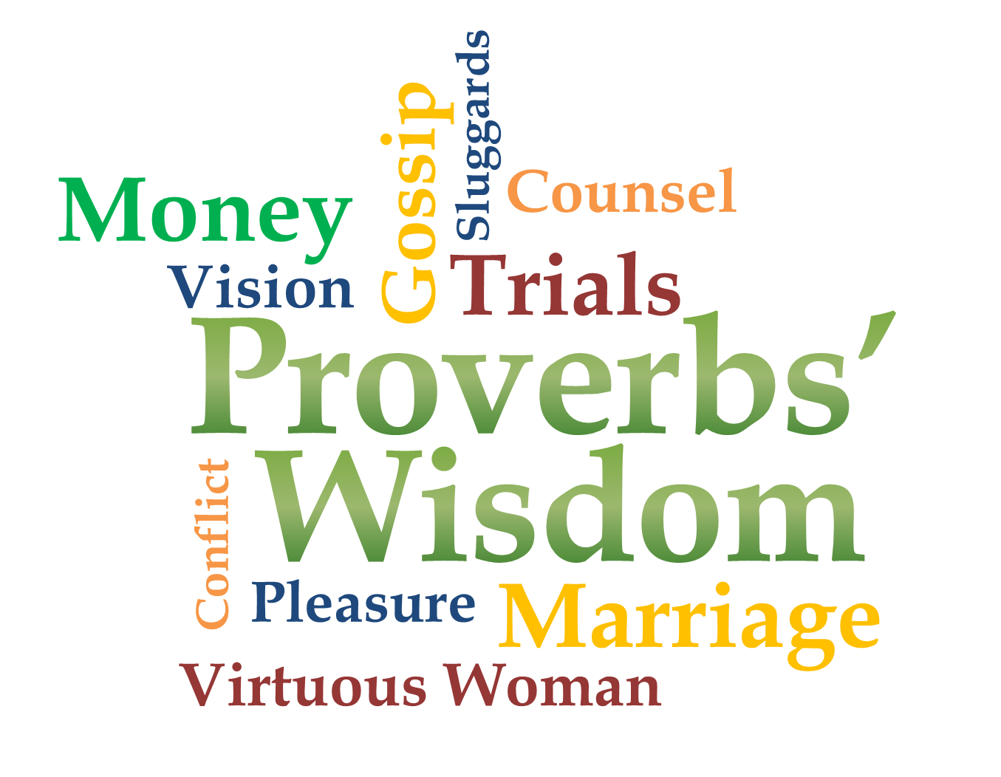
Week 9
Virtuous Woman

Slide 3
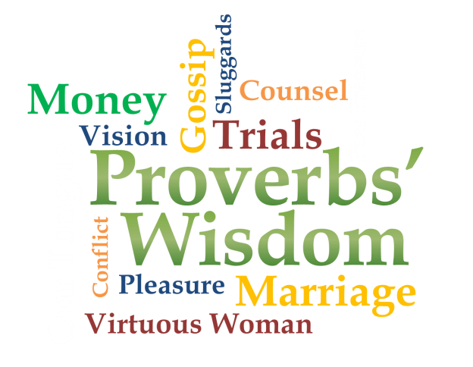
Turn to Proverbs 31
Potential

Slide 4
Proverbs 31:10-12
Her Character

Slide 5
Proverbs 31:10-12
¹⁰ A wife of noble character (virtuous wife) who can find? She is worth far more than rubies. ¹¹ Her husband has full confidence in her and lacks nothing of value. ¹² She brings him good, not harm, all the days of her life.

Slide 6
Proverbs 31:10-12
Her Character
Proverbs 12:4
A wife of noble character is her husband's crown, but a disgraceful wife is like decay in his bones.

Slide 7
Proverbs 31:13-24
Her Role

Slide 8
Proverbs 31:13-24
¹³ She selects wool and flax and works with eager hands. ¹⁴ She is like the merchant ships, bringing her food from afar. ¹⁵ She gets up while it is still dark; she provides food for her family and portions for her servant girls.

Slide 9
Proverbs 31:13-24
¹⁶ She considers a field and buys it; out of her earnings she plants a vineyard. ¹⁷ She sets about her work vigorously; her arms are strong for her tasks. ¹⁸ She sees that her trading is profitable, and her lamp does not go out at night.

Slide 10
Proverbs 31:13-24
¹⁹ In her hand she holds the distaff and grasps the spindle with her fingers. ²⁰ She opens her arms to the poor and extends her hands to the needy. ²¹ When it snows, she has no fear for her household; for all of them are clothed in scarlet.

Slide 11
Proverbs 31:13-24
²² She makes coverings for her bed; she is clothed in fine linen and purple. ²³ Her husband is respected at the city gate, where he takes his seat among the elders of the land. ²⁴ She makes linen garments and sells them, and supplies the merchants with sashes.

Slide 12
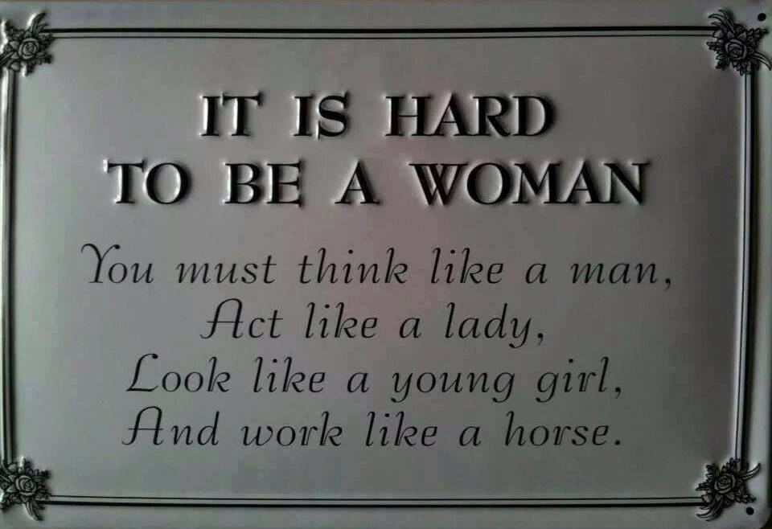
Proverbs 31:13-24

Slide 13
Proverbs 31:25-26
Her Strength

Slide 14
Proverbs 31:25-26
²⁵ She is clothed with strength and dignity; she can laugh at the days to come. ²⁶ She speaks with wisdom, and faithful instruction is on her tongue.

Slide 15
Proverbs 31:25-26
Her Strength
Proverbs 19:14
Houses and wealth are inherited from parents, but a prudent wife is from the LORD.

Slide 16
Proverbs 31:25-26
Her Strength
Prudent: acute mental discernment and keen practical sense in adapting means to ends; discreet; sensible; frugal; not extravagant

Slide 17
Proverbs 31:27-29
Her Investment

Slide 18
Proverbs 31:27-29
²⁷ She watches over the affairs of her household and does not eat the bread of idleness. ²⁸ Her children arise and call her blessed; her husband also, and he praises her: ²⁹ “Many women do noble things, but you surpass them all.”

Slide 19
Proverbs 31:27-29
Her Investment
Proverbs 14:1
The wise woman builds her house, but with her own hands the foolish one tears hers down.

Slide 20
Proverbs 31:30-31
She is worthy of honor!

Slide 21
Proverbs 31:30-31
³⁰ Charm is deceptive, and beauty is fleeting; but a woman who fears the LORD is to be praised. ³¹ Give her the reward she has earned, and let her works bring her praise at the city gate.

Slide 22
Our prayer for women
Remove condemnation
Relationships
Balance
Strength
Provision
Healing
Loved

