Slide 1
The Wheat and Tares
Notes:
Grasslands
(Basic)
Note: This template is optimized for PowerPoint 2010 and uses a video background. If used in PowerPoint 2007, video elements will play, but all content will be covered by video background when in slideshow. If used in PowerPoint 2003, video will not play, but the poster frame of the videos will remain in place as a static image.
The video:
Plays automatically after each slide transition.
Is 30 seconds long.
Seamlessly loops for infinite playback.
To add slides or change layout, do the following:
To add a new slide, on the Home tab, in the Slides group, click the arrow under New Slide, then click under Motion Background Theme select the desired layout.
To change the layout of an existing slide, on the Home tab, in the Slides group, click Layout, then select the desired layout.
This template uses the “Pushpin” Theme Font. To access or change the Theme Font, do the following:
On the View tab in the Master Views group, select Slide Master.
In the Slide Master view, select slide 1 (the Master Slide for Master Layouts that use the video background).
On the Slide Master tab, in the Edit Theme group, click Fonts, and then select new theme fonts.
Using animated elements:
Any animated element will begin after the slide transition and the background video has started.

Slide 2
Matthew 13:18-30
The Parable of the Sower explains that the seed is the Word of God
The Parable of the Wheat and tares describe a “false” gospel being taught in midst of the truth

Slide 3
Matthew 13:30
“ … Let both grow together until the harvest, and at the time of harvest I will say to the reapers, “First gather together the tares and bind them in bundles to burn them, but gather the wheat into my barn.”

Slide 4
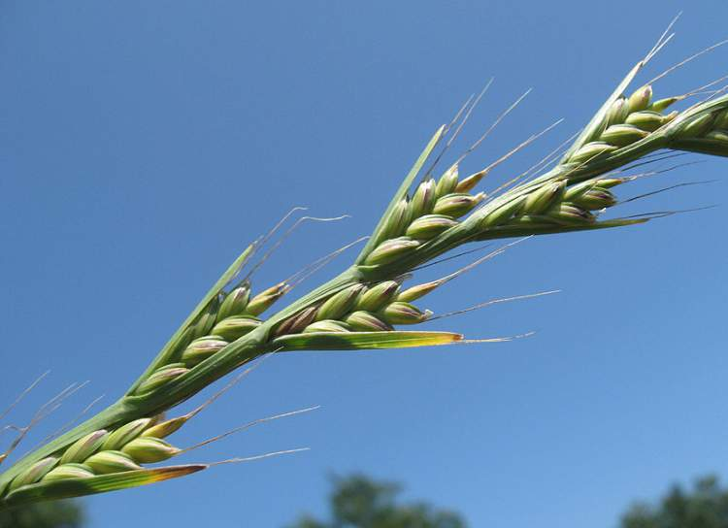

Slide 5
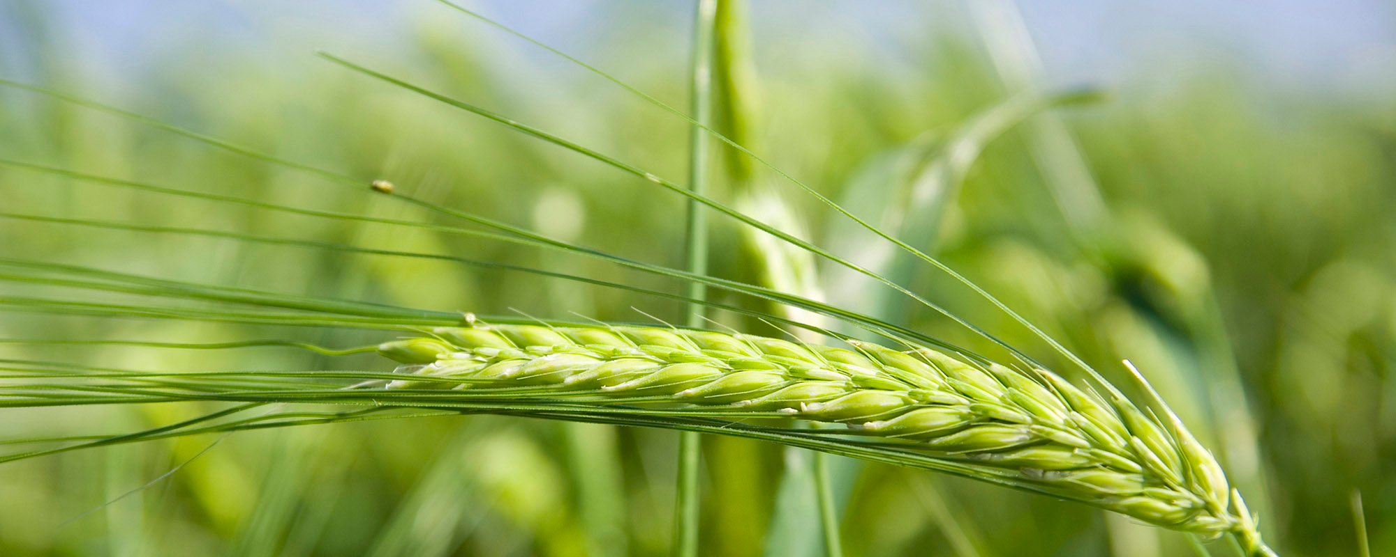

Slide 6
Which is wheat, which is tares?

Slide 7
What are tares?
Lolium temulentum, typically known as darnel, poison darnel, darnel ryegrass or cockle, is an annual plant that can grow up to one meter tall, with inflorescence in the ears and purple grain.
The similarity between darnel and wheat is so great that in some regions, darnel is referred to as "false wheat". It bears a close resemblance to wheat until the ear appears. The wheat will appear brown when ripe, whereas the darnel is black.

Slide 8
When darnel is ground into flour, baked in bread, and consumed while hot, the eater may experience symptoms similar to drunkenness, including trembling, followed by an inability to walk, hindered speech, and vomiting. In addition, darnel is commonly infected by the ergot fungus, which can cause hallucinations when consumed in small doses, but in large doses can do heavy damage to the central nervous system causing numbness and sometimes blindness.

Slide 9
Tares are False teaching/beliefs
Many orthodox beliefs have been replaced by counterfeit versions of truth
Many people have ingested these beliefs, and become spiritually “toxic” or intoxicated
The results are blindness, vain imaginations, and rebellion against God; refusing to keep His commandments and rejecting the absolute authority of His Word.

Slide 10
Tares are False teaching/beliefs
Spiritual wheat and tares grow alike within God's church, identical in appearance, and to attempt to uproot the tares would result in uprooting some of the wheat as well.
Just as the difference between the mature fruit of wheat and darnel is different, only by the fruit may the teaching of truth be known (Matthew 7:15-20).
Even after maturity, God Himself—and no one else—will have the tares removed and will destroy them in the furnace (Matthew 13:30).

Slide 11
A Tree and Its Fruit
“Beware of false prophets, who come to you in sheep's clothing but inwardly are ravenous wolves. You will recognize them by their fruits. Are grapes gathered from thorn-bushes, or figs from thistles? So, every healthy tree bears good fruit, but the diseased tree bears bad fruit. A healthy tree cannot bear bad fruit, nor can a diseased tree bear good fruit. Every tree that does not bear good fruit is cut down and thrown into the fire. Thus you will recognize them by their fruits. Matthew 7:15

Slide 12
I Never Knew You
“Not everyone who says to me, ‘Lord, Lord,’ will enter the kingdom of heaven, but the one who does the will of my Father who is in heaven. On that day many will say to me, ‘Lord, Lord, did we not prophesy in your name, and cast out demons in your name, and do many mighty works in your name?’ And then will I declare to them, ‘I never knew you; depart from me, you workers of lawlessness.’ Matthew 7:21

Slide 13
2 Peter 2:1-3, 9 (excerpts from The Message)
But there were also lying prophets among the people then, just as there will be lying religious teachers among you. They smuggle in destructive divisions, pitting you against each other…
They’ve put themselves on a fast downhill slide to destruction, but not before they recruit a crowd of mixed-up followers who can’t tell right from wrong.
They give the way of truth a bad name. ..
They’ll say anything, anything, that sounds good to exploit you.
God has never just stood by and let that kind of thing go on.
So God knows how to rescue the godly from evil trials. And he knows how to hold the feet of the wicked to the fire until Judgment Day.

Slide 14
Matthew 24 & 25
24:24 For there shall arise false Christs, and false prophets, and shall shew great signs and wonders; insomuch that, if it were possible, they shall deceive the very elect.
25:31 When the Son of Man comes in his glory, and all the angels with him, then he will sit on his glorious throne. Before him will be gathered all the nations, and he will separate people one from another as a shepherd separates the sheep from the goats. And he will place the sheep on his right, but the goats on the left.

Slide 15
The Kingdom of God
I was hungry and you gave me food, I was thirsty and you gave me drink, I was a stranger and you welcomed me, I was naked and you clothed me, I was sick and you visited me, I was in prison and you came to me. Then the righteous will answer him, saying, ‘Lord, when did we see you hungry and feed you, or thirsty and give you drink? And when did we see you a stranger and welcome you, or naked and clothe you? And when did we see you sick or in prison and visit you?’ And the King will answer them, ‘Truly, I say to you, as you did it to one of the least of these my brothers, you did it to me.’

Slide 16
“Love them all ,
I will sort them out later”
And the King will answer them, ‘Truly, I say to you, as you did it to one of the least of these my brothers, you did it to me.’

