Slide 2

Week 3 | Battle for Kingship

Slide 3
Matthew chapter 2

Slide 4
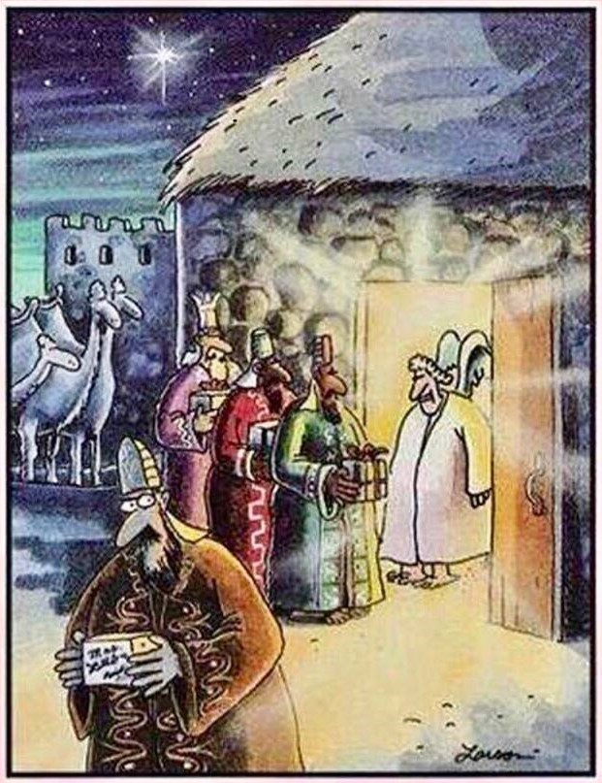
Unbeknownst to most theologians, there was a fourth wiseman, who was turned away for bringing fruitcake

Slide 5
Jesus is King!
³⁶ Jesus said, “My kingdom is not of this world. If it were, my servants would fight to prevent my arrest by the Jewish leaders. But now my kingdom is from another place.” ³⁷ “You are a king, then!” said Pilate. Jesus answered, “You say that I am a king. In fact, the reason I was born and came into the world is to testify to the truth. Everyone on the side of truth listens to me.” (John 18:36-37)

Slide 6
Satan aiming to destroy Jesus
Revelation 12:1-4
Main emphasis of the OT is that Israel is pregnant and in labor
Genesis 3:15 “I will put enmity between you and the woman, and between your offspring and hers; he will crush your head, and you will strike his heel.”

Slide 7
Satan aiming to destroy Jesus
Cain slays Abel
Seth replaces Abel. Satan knows the promise is in him so tries to get Seth's descendants to intermarry Cain's
The flood- one of Seth’s descendants survives: Noah- who God selects, the promise is continued
Tower of Babel- tries to obliterate the distinction

Slide 8
Satan aiming to destroy Jesus
Abraham- seemingly has no heir so the promise can't be fulfilled
Isaac- Abraham must sacrifice him
Jacob- Esau wants to kill him
Exodus- Egypt tries to destroy the nation of Israel
Moses intercedes that God would not destroy the nation

Slide 9
Satan aiming to destroy Jesus
Saul tries to kill David
Queen Athaliah kills all of the royal seed (Joash was hidden away)
Queen Esther appeals to the king that the Jews would be spared from Mordecai’s plan
Herod destroys all the males under 2 years old of Bethlehem except for the Christ-child!

Slide 10
Satan aiming to destroy Jesus
All of Biblical history becomes one story, the story of the conflict between the seed of the woman and the dragon, between Jesus and Satan

Slide 11
Battle for Kingship
Our lives are constantly under attack to dethrone Jesus as King!

Slide 12
Battle for Kingship
“Each one of us is an innkeeper who decides if there is room for Jesus”
-unknown

Slide 13
Matthew 2:19-23
“Out of Egypt I called my son”
Not just conflict but DELIVERANCE!

