Slide 2
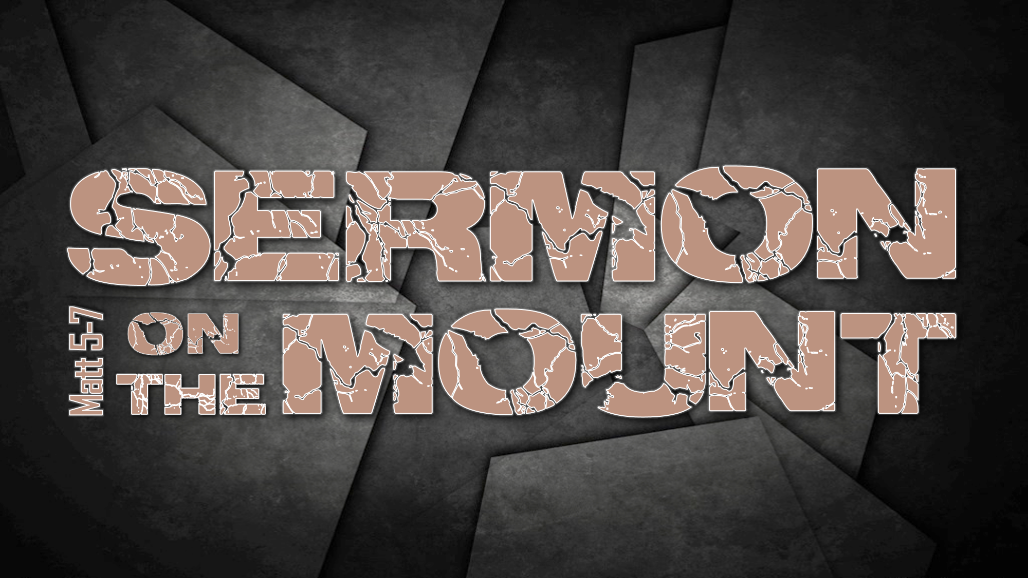
WEEK 1 ¤ THE BEATITUDES ¤ MATT 5:1-12

Slide 3
sermon on the mount
Jesus’ teachings cannot be understood apart from the announcement of the Kingdom
outlines ethics of the present experience
of Kingdom living
He explains what a Kingdom citizen looks like
emphasis is on inside-out transformation, not external performance

Slide 4
sermon on the mount
God’s perfect expression of his moral will
impossible for humans to maintain, therefore forces us to recognize our sinfulness and cry out for God’s grace in repentance
His description of life in the Kingdom includes the enablement to attain the ideal

Slide 5
the beatitudes
blessed (makarioi) is the opposite of the pronouncement of “woe”
happy, fortunate are you, approved of by God, possessing the favor of God
“congratulations!”
“I am with you!”

Slide 6
the beatitudes
they reveal the values of the Kingdom
they are not entrance requirements to
access the Kingdom
the individual beatitudes are not
self-produced. They are products of a life energized by the Spirit of God

Slide 7
³ blessed are the poor in spirit
two Greek words for poor:
penes (pen'-ace), describes the man who has nothing except the bare necessities and has to toil for daily existence
ptochos (pto-khos'), describes the man who has nothing at all. Absolute and abject poverty; a beggar, a pauper

Slide 8
³ blessed are the poor in spirit
the destitute, the spiritually bankrupt
monumental debt with no resources to repay
the doctrine of the depravity of man
not self-reliant, self-confident, self-centered, or self-sufficient
spiritually humble

Slide 9
³ blessed are the poor in spirit
Isaiah 66:1-2 (CEV) ¹ The LORD said: Heaven is
my throne; the earth is my footstool. What kind of house could you build for me? In what place will I rest? ² I have made everything; that's how it all came to be. I, the LORD, have spoken. The people I treasure most are the humble– they depend only on me and tremble when I speak.

Slide 10
³ blessed are the poor in spirit
the man who has no spiritual resource whatsoever puts his whole trust in God
Jesus speaks of the kingdom of heaven as
a present possession
nobody gets into heaven who thinks they have cause to be there, other than that cause being Christ

Slide 11
⁴ blessed are those who mourn
capable of two meanings:
those afflicted with the loss of family, friends, or possessions
more likely- those who mourn over sin
those who mourn acknowledge their sins
and spiritual poverty

Slide 12
⁴ blessed are those who mourn
2 Corinthians 7:10-11 ¹⁰ Godly sorrow brings repentance that leads to salvation and leaves no regret… ¹¹ See what this godly sorrow has produced in you: what earnestness, what eagerness to clear yourselves, what indignation, what alarm, what longing, what concern, what readiness to see justice done…

Slide 13
⁵ blessed are the meek
does not imply weakness
people who do not assert themselves over others in order to advance their own causes
not quick-tempered, arrogant, or proud
don’t have to win or have the last word
bears injustice patiently and without bitterness

Slide 14
⁵ blessed are the meek
surrenders everything to the Lord and
His control
have a belief that God will vindicate them
quotes Psalm 37:11
    But the meek will inherit the land and
    enjoy peace and prosperity.

Slide 15
⁶ blessed are those who hunger and
thirst for righteousness
a famishing, all-consuming craving of the soul for God and his righteousness
in dire need, will perish if not filled
hunger and thirst are appetites that are
not one-time needs
they call for fresh satisfactions

Slide 16
⁶ blessed are those who hunger and
thirst for righteousness
such desire is evidence of dissatisfaction with present spiritual attainment
they will be filled (gorged)

Slide 17
⁷ blessed are the merciful
those who demonstrate forgiveness toward the guilty & tenderness for hurting and needy
identification with the other person and
their situation
realizing our battle isn’t against flesh and blood
everyone desires mercy, few want to give it

Slide 18
⁸ blessed are the pure in heart
does not mean those without sin
a heart that is in opposition to mixture
our thoughts, desires, motives, principles, actions, loyalties
do not attempt to serve the world and God
at the same time

Slide 19
⁸ blessed are the pure in heart
Psalm 24:3-6
³ Who may ascend the hill of the LORD? Who may stand in his holy place? ⁴ He who has clean hands and a pure heart, who does not lift up his soul to an idol or swear by what is false. ⁵ He will receive blessing from the LORD and vindication from God his Savior. ⁶ Such is the generation of those who seek him, who seek your face, O God of Jacob.

Slide 20
⁹ blessed are the peacemakers
bring harmony (getting along)
gas can or watering pot?
actively bring about peace and salvation
Isaiah 52:7 How beautiful on the mountains are the feet of those who bring good news, who proclaim peace, who bring good tidings, who proclaim salvation, who say to Zion, “Your God reigns!”

Slide 21
¹⁰ blessed are those who are persecuted
because of righteousness
2 Tim 3:12 In fact, everyone who wants to
live a godly life in Christ Jesus will be persecuted.
1 Peter 3:14 But even if you should suffer for what is right, you are blessed. “Do not fear their threats; do not be frightened.”

Slide 22
¹¹ blessed are you when people insult you
we can’t love our lives so much as to
shrink from death (or ridicule)
unbelievers take believers’ changed lives as a rebuke to their sinful lifestyle
“because of Me”
the natural tendency for us is to defend ourselves- Jesus said “rejoice and be glad”

Slide 23
¹¹ blessed are you when people insult you
rejoice, not despite the persecution, but because of it!
Jesus comforts the persecuted:
… theirs is the kingdom of heaven (vs. 10)
… great is your reward in heaven (vs. 12)
    (present tense declarations)

