Slide 2
Week 6 | Temptations

Slide 3
Matthew 4:1-11

Slide 4
Jesus’ preparation for earthly ministry
Baptized
Spirit filled
Spirit led
Prayed and fasted
Time w/ God
Self-denial
Had to overcome temptation

Slide 5
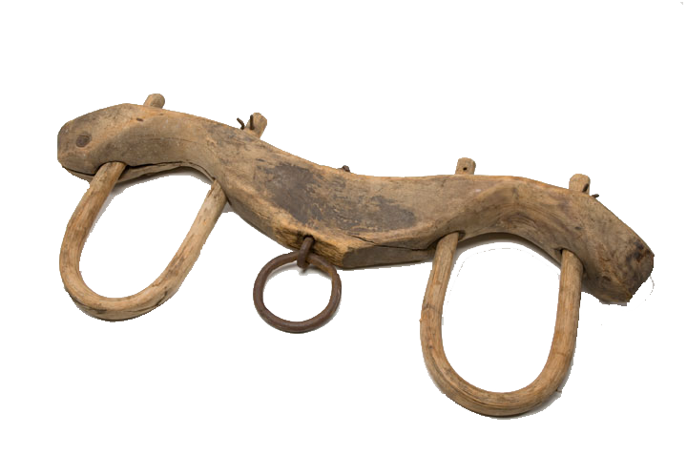
Temptation
Inducement to sin placed before the mind with the implied promise of greater good to be derived from following the way of disobedience
Sin’s insidious yoke

Slide 6
Isaiah 14:12-14
¹² How you have fallen from heaven, morning star, son of the dawn! You have been cast down to the earth, you who once laid low the nations! ¹³ You said in your heart, “I will ascend to the heavens; I will raise my throne above the stars of God; I will sit enthroned on the mount of assembly, on the utmost heights of Mount Zaphon. ¹⁴ I will ascend above the tops of the clouds; I will make myself like the Most High.”

Slide 7
Isaiah 14:12-14
¹² How you have fallen from heaven, morning star, son of the dawn! You have been cast down to the earth, you who once laid low the nations! ¹³ You said in your heart, “I will ascend to the heavens; I will raise my throne above the stars of God; I will sit enthroned on the mount of assembly, on the utmost heights of Mount Zaphon. ¹⁴ I will ascend above the tops of the clouds; I will make myself like the Most High.”

Slide 8
Satan’s character
The sin of Satan is pride and attempting to be equal to God in status and authority
1 Tim 3:6 He must not be a recent convert, or he may become conceited and fall under the same judgment as the devil.

Slide 9
3-4
The Tempter said…
He tries to:
- pervert our appetites
“Did God really say, You must not eat from any tree in the garden?”
- dissuade our obedience
- entice us to be self-sufficient

Slide 10
5-7
The Tempter said…
He tries to:
- convince us there are no consequences
“You will not surely die”
- dissuade our trust in Him
- entice us to be self-healing

Slide 11
8-10
The Tempter said…
He tries to:
- manipulate lordship
“You will be like God”
- dissuade following Him
- entice us with power; to be self-exalting

Slide 12
Ephesians 6:11-12
¹¹ Put on the full armor of God, so that you can take your stand against the devil’s schemes. ¹² For our struggle is not against flesh and blood, but against the rulers, against the authorities, against the powers of this dark world and against the spiritual forces of evil in the heavenly realms.

Slide 13
“Satan rose up against Israel and incited David to take a census of Israel.”
(1 Chronicles 21:1)

Slide 14
James 1:13-15
¹³ When tempted, no one should say, “God is tempting me.” For God cannot be tempted by evil, nor does He tempt anyone;
Satan tempts
(incites us to sin)
God tests
(uses all things for us)
Trials are to be endured; Temptations are to be avoided

Slide 15
James 1:13-15
¹³ When tempted, no one should say, “God is tempting me.” For God cannot be tempted by evil, nor does He tempt anyone; ¹⁴ but each person is tempted when they are dragged away by their own evil desire and enticed. ¹⁵ Then, after desire has conceived, it gives birth to sin; and sin, when it is full-grown, gives birth to death.

Slide 16
“own evil desire” – Our fallen nature
Proverbs 19:3 (NLT)
People ruin their lives by their own foolishness and then are angry at the Lord.
Emphasis of the NT is on telling believers not to sin more than on Satan’s activity

Slide 17
Overcoming Temptations
1 Corinthians 10:13 (NIV84)
No temptation has seized you except what is common to man. And God is faithful; He will not let you be tempted beyond what you can bear. But when you are tempted, He will also provide a way out, so that you can stand up under it.

Slide 18
Overcoming Temptations
1 Corinthians 10:13 (NIV84)
No temptation has seized you except what is 1) common to man. And God is faithful; He will not let you be tempted beyond what you can bear. But when you are tempted, He will also provide a way out, so that you can stand up under it.

Slide 19
Overcoming Temptations
1 Corinthians 10:13 (NIV84)
No temptation has seized you except what is 1) common to man. And 2) God is faithful; He will not let you be tempted beyond what you can bear. But when you are tempted, He will also provide a way out, so that you can stand up under it.

Slide 20
Overcoming Temptations
1 Corinthians 10:13 (NIV84)
No temptation has seized you except what is 1) common to man. And 2) God is faithful; 3) He will not let you be tempted beyond what you can bear. But when you are tempted, He will also provide a way out, so that you can stand up under it.

Slide 21
Overcoming Temptations
1 Corinthians 10:13 (NIV84)
No temptation has seized you except what is 1) common to man. And 2) God is faithful; 3) He will not let you be tempted beyond what you can bear. But when you are tempted, 4) He will also provide a way out, so that you can stand up under it.

Slide 22
Overcoming Temptations
Psalm 119:11
5) Your word I have hidden in my heart, that I might not sin against You.
Luke 22:40
When He came to the place, He said to them, 6) “Pray that you may not enter into temptation.”

Slide 23
Overcoming Temptations
Hebrews 4:15-16 (NLT)
¹⁵ This High Priest of ours understands our weaknesses, for He faced all of the same temptations we do, yet he did not sin. ¹⁶ So let us come boldly to the throne of our gracious God. There we will 7) receive His mercy, and we will find grace to help us when we need it.

Slide 24
Overcoming Temptations
James 4:7-8
8) ⁷ Submit yourselves, then, to God. 9) Resist the devil, and he will flee from you. ⁸ Come near to God and He will come near to you. Wash your hands, you sinners, and purify your hearts, you double-minded.

Slide 25
After the temptation
Matthew 4:11
Then the devil left him, and angels came and attended him.
Luke 4:13
When the devil had finished every temptation, he left Him until an opportune time.

