Slide 1
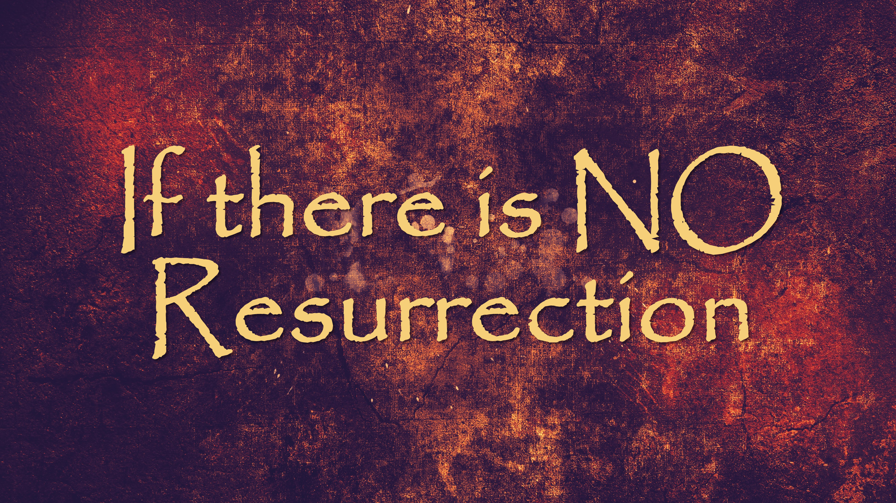

Slide 2
1 Corinthians 15:12-22
¹² But if it is preached that Christ has been raised from the dead, how can some of you say that there is no resurrection of the dead?

Slide 3
1 Corinthians 15:12-22
¹³ If there is no resurrection of the dead, then not even Christ has been raised. ¹⁴ And if Christ has not been raised, our preaching is useless and so is your faith.

Slide 4
1 Corinthians 15:12-22
¹³ If there IS no resurrection of the dead, then not even Christ has been raised. ¹⁴ And if Christ has not been raised, our preaching is useless and so is your faith.
Present tense

Slide 5
1 Corinthians 15:12-22
¹³ If there IS no resurrection of the dead, then not even Christ has been raised. ¹⁴ And if Christ has not been raised, our preaching is useless and so is your faith.

Slide 6
1 Corinthians 15:12-22
¹⁵ More than that, we are then found to be false witnesses about God, for we have testified about God that he raised Christ from the dead. But he did not raise him if in fact the dead are not raised.
We misrepresent God if there
IS no resurrection

Slide 7
1 Corinthians 15:12-22
¹⁵ More than that, we are then found to be false witnesses about God, for we have testified about God that he raised Christ from the dead. But he did not raise him if in fact the dead are not raised.
¹⁶ For if the dead are not raised, then Christ has not been raised either.

Slide 8
1 Corinthians 15:12-22
¹⁷ And if Christ has not been raised, your faith is futile; you are still in your sins.
Incapable of producing any
useful result; pointless
If there IS not resurrection,
Christianity does not "work"

Slide 9
1 Corinthians 15:12-22
¹⁷ And if Christ has not been raised, your faith is futile; you are still in your sins.
“The gospel is news about what God has already done for you, rather than instruction and advice about what you are to do for God.” –Tim Keller

Slide 10
1 Corinthians 15:12-22
¹⁸ Then those also who have fallen asleep in Christ are lost. ¹⁹ If only for this life we have hope in Christ, we are of all people most to be pitied. ²⁰ But Christ has indeed been raised from the dead, the firstfruits of those who have fallen asleep.

Slide 11
1 Corinthians 15:12-22
²¹ So you see, just as death came into the world through a man, now the resurrection from the dead has begun through another man. ²² Just as everyone dies because we all belong to Adam, everyone who belongs to Christ will be given new life.

Slide 12
Romans 8:10-11
¹⁰ But if Christ is in you, then even though your body is subject to death because of sin, the Spirit gives life because of righteousness. ¹¹ And if the Spirit of Him who raised Jesus from the dead is living in you, He who raised Christ from the dead will also give life to your mortal bodies because of His Spirit who lives in you.

Slide 13
Romans 8:10-11
¹⁰ But if Christ is in you, then even though your body is subject to death because of sin, the Spirit gives life because of righteousness. ¹¹ And if the Spirit of Him who raised Jesus from the dead is living in you, He who raised Christ from the dead will also give life to your mortal bodies because of His Spirit who lives in you.

Slide 14
Romans 8:10-11
¹⁰ But if Christ is in you, then even though your body is subject to death because of sin, the Spirit gives life because of righteousness. ¹¹ And if the Spirit of Him who raised Jesus from the dead is living in you, He who raised Christ from the dead will also give life to your mortal bodies because of His Spirit who lives in you.

