Slide 1
WEEK 14 “THE GOLDEN RULE”
MATT 7:1-12

Slide 2
Matthew 7:12
So in everything, do to others what you would have them do to you, for this sums up the Law and the Prophets.

Slide 3
context, context, context

Slide 4
7:1-4
do not judge
krino- decide (mentally or judicially)
condemn, damn, conclude, discriminate, sentence, think
presumptuously passing judgment upon others

Slide 5
7:1-4
do not judge
Romans 14:10
You, then, why do you judge your brother? Or why do you look down on your brother? For we will all stand before God’s judgment seat.

Slide 6
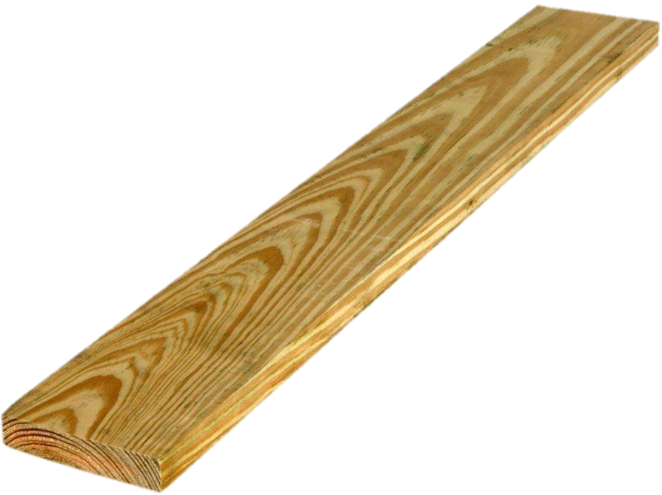
7:1-4
do not judge
why do you look… but pay no attention to your own?
may suggest a blind, insensitive, self-deceived person

Slide 7
7:5
“hypocrite”
why do you look… but pay no attention to your own?
may suggest a blind, insensitive, self-deceived person
maybe they aren’t so unaware

Slide 8
7:5
removing the speck
first, take the plank out
…you will see clearly
we can assist in “removing specks” only when we’ve dealt with any critical spirit or self-righteousness

Slide 9
7:5
removing the speck
Galatians 6:1 Brothers, if someone is caught in a sin, you who are spiritual should restore him gently. But watch yourself, or you also may be tempted.
focus is restoration— not punishment

Slide 10
7:5
removing the speck
Galatians 6:1 Brothers, if someone is caught in a sin, you who are spiritual should restore him gently. But watch yourself, or you also may be tempted.
focus is restoration— not punishment

Slide 11
1 Corinthians 2:14-16
¹⁴ The person without the Spirit does not accept the things that come from the Spirit of God but considers them foolishness, and cannot understand them because they are discerned only through the Spirit.

Slide 12
1 Corinthians 2:14-16
¹⁵ The person with the Spirit makes judgments about all things, but such a person is not subject to merely human judgments, ¹⁶ for, “Who has known the mind of the Lord so as to instruct him?” But we have the mind of Christ.

Slide 13
7:5
removing the speck
Galatians 6:1 Brothers, if someone is caught in a sin, you who are spiritual should restore him gently. But watch yourself, or you also may be tempted.
sin of self-righteousness
falling prey to the same sin

Slide 14
7:6
dogs and pigs
2 Peter 2:22 Of them the proverbs are true: “A dog returns to its vomit,” and, “A sow that is washed returns to her wallowing in the mud.”
discernment as opposed to judgment

Slide 15
7:7-8
ask, seek, knock
keep on keepin’ on!
become…
askers
seekers
knockers

Slide 16
7:9-12
in context…
praying for them
those we are tempted to judge
those who need to be restored
for discernment and mercy
with the same concern that a parent would have

Slide 17
Matthew 7:12
So in everything, do to others what you would have them do to you, for this sums up the Law and the Prophets.

