Slide 2
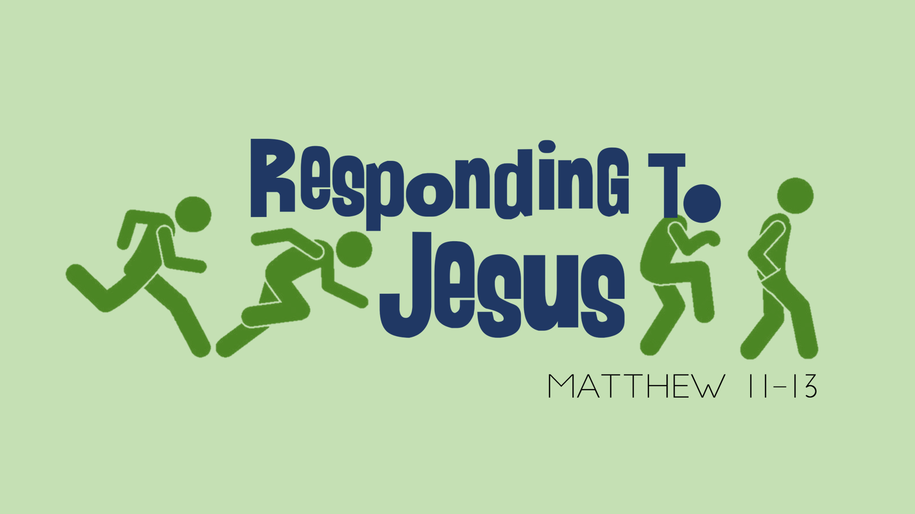

Slide 3

Week Three Deliverance by Jesus
Matthew 12:15-37

Slide 4
No Middle Ground

Slide 5
The
Unforgivable
Sin

Slide 6
1. Complete denial

Slide 7
2. Attributing what is from the Holy Spirit to Satan

Slide 8
Mark 3:28-30
²⁸ Truly I tell you, people can be forgiven all their sins and every slander they utter, ²⁹ but whoever blasphemes against the Holy Spirit will never be forgiven; they are guilty of an eternal sin.” ³⁰ He said this because they were saying, “He has an impure spirit.”

Slide 9
Have I committed this sin?

Slide 10
the problem of such speech lies not in the tongue but in the heart

Slide 11
Deliverance

Slide 12
Matthew 12:28
“But if I drive out demons by the Spirit of God, then the kingdom of God has come upon you.”
The Demonic

Slide 13
Ephesians 6:12
For our struggle is not against flesh and blood, but against the rulers, against the authorities, against the powers of this dark world and against the spiritual forces of evil in the heavenly realms

Slide 14
We see in Scripture:
demons can cause illness and physical affliction (but not all illness and affliction is demonic)
can possess or control a person
can speak through a person

Slide 15
Demons and Christians?

Slide 16
2 Corinthians 11:3-4
³ But I am afraid that just as Eve was deceived by the serpent’s cunning, your minds may somehow be led astray from your sincere and pure devotion to Christ. ⁴ For if someone comes to you and preaches a Jesus other than the Jesus we preached, or if you receive a different spirit from the one you received, or a different gospel from the one you accepted, you put up with it easily enough.

Slide 17
1 Timothy 4:1
The Spirit clearly says that in later times some will abandon the faith and follow deceiving spirits and things taught by demons.

Slide 18
Possession or Oppression?
Possession suggests total control (in spirit)
Oppression suggests strong influence more than temptation –demonic stronghold (in soul and body)

Slide 19
“A Christian can ‘have’ a demon, just as they can have a sickness or disease. Saying a Christian can be possessed, is like saying that a person’s body is owned by an infection on that person’s finger. The infection may ‘influence’ the body, but it does not mean that is ‘owns’ the body. The same is true here: while a Christian can have a demon and be in bondage (influenced), it does not mean that the person is owned by the demon.”

Slide 20
How do Demons enter?

Slide 21
Doorways opened:
Habitual Sin
Abuse (emotional, mental, physical)
Past dealings with the occult
Ungodly soul ties—sexual sin
Unforgiveness
Sensory gates

Slide 22
Possible evidence of demons:
Addictions or sins that cannot be totally overcome
Chronic illnesses
Unusual crippling fears
Chronic relationship difficulties
Suicidal thoughts
Extreme behavior

Slide 23
Matthew 12:28
“But if I drive out demons by the Spirit of God, then the kingdom of God has come upon you.”
The Holy Spirit

Slide 24
The Holy Spirit liberates people from Demons!

Slide 25
2 Corinthians 3:17
Now the Lord is the Spirit, and where the Spirit of the Lord is, there is freedom.

Slide 26
We have His Authority

Slide 27
James 4:7
Submit yourselves, then, to God. Resist the devil, and he will flee from you.

Slide 28
Mark 16:17-18
¹⁷ And these signs will accompany those who believe: In my name they will drive out demons; they will speak in new tongues; ¹⁸ they will pick up snakes with their hands; and when they drink deadly poison, it will not hurt them at all; they will place their hands on sick people, and they will get well.”

Slide 29
Matthew 12:28
“But if I drive out demons by the Spirit of God, then the kingdom of God has come upon you.”

