Slide 3
Week Two Resting in Jesus
Matthew 11:20-12:14

Slide 4
Matthew 11:28-30 (NIV)
²⁸ “Come to me, all you who are weary and burdened, and I will give you rest. ²⁹ Take my yoke upon you and learn from me, for I am gentle and humble in heart, and you will find rest for your souls. ³⁰ For my yoke is easy and my burden is light.”

Slide 5
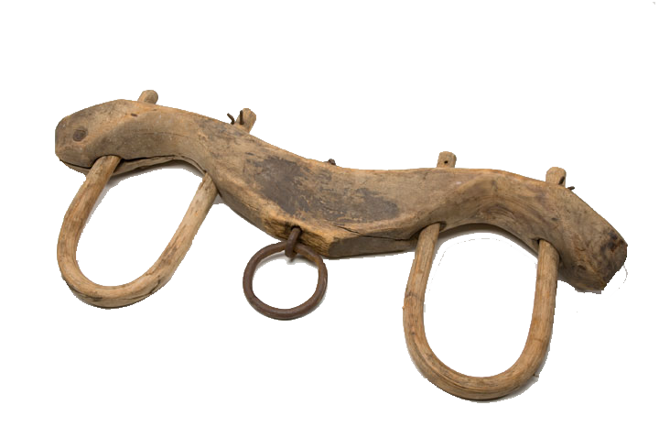
He takes the heavy end!

Slide 6
Matthew 11:28-30 (MSG)
“Are you tired? Worn out? Burned out on religion? Come to me. Get away with me and you'll recover your life. I'll show you how to take a real rest. Walk with me and work with me—watch how I do it. Learn the unforced rhythms of grace. I won't lay anything heavy or ill-fitting on you. Keep company with me and you'll learn to live freely and lightly.”

Slide 7
The Sabbath

Slide 8
Mark 2:27-28 (NLT)
²⁷ Then Jesus said to them, “The Sabbath was made to meet the needs of people, and not people to meet the requirements of the Sabbath. ²⁸ So the Son of Man is Lord, even over the Sabbath!”

Slide 9
The Sabbath

Slide 10
Colossians 2:13-17 (NLT)
¹³ You were dead because of your sins and because your sinful nature was not yet cut away. Then God made you alive with Christ, for he forgave all our sins. ¹⁴ He canceled the record of the charges against us and took it away by nailing it to the cross. ¹⁵ In this way, he disarmed the spiritual rulers and authorities. He shamed them publicly by his victory over them on the cross.

Slide 11
Colossians 2:13-17 (NLT)
¹⁶ So don’t let anyone condemn you for what you eat or drink, or for not celebrating certain holy days or new moon ceremonies or Sabbaths. ¹⁷ For these rules are only shadows of the reality yet to come. And Christ himself is that reality.

Slide 12
The Shadow of things to Come...:

Slide 13
Exodus 31:13
“Say to the Israelites, ‘You must observe my Sabbaths. This will be a sign between Me and you for the generations to come, so you may know that I am the LORD, who makes you holy. (Gives you rest from your striving to be holy)

Slide 14
What Has Come...:

Slide 15
Hebrews 10:9-10 (NLT)
⁹…He cancels the first covenant in order to put the second into effect. ¹⁰ For God’s will was for us to be made holy by the sacrifice of the body of Jesus Christ, once for all time. (Gives you rest from your striving to be holy, once and for all)

Slide 16
Old Covenant:
the Sabbath was a Covenant Sign Between Man and God

Slide 17
New Covenant:
Jesus is the Covenant Sign Between Man and God!

Slide 18
Matthew 5:17
“Do not think that I have come to abolish the Law or the Prophets; I have not come to abolish them but to fulfill them.
He came to Be our Sabbath

Slide 19
Galatians 4:8-11
⁸ Formerly, when you did not know God, you were slaves to those who by nature are not gods. ⁹ But now that you know God—or rather are known by God—how is it that you are turning back to those weak and miserable forces? Do you wish to be enslaved by them all over again? ¹⁰ You are observing special days and months and seasons and years! ¹¹ I fear for you, that somehow I have wasted my efforts on you.

Slide 20
The Church is not Commanded to Keep a day holy

Slide 21
Romans 14:5-6
⁵ One person considers one day more sacred than another; another considers every day alike. Each of them should be fully convinced in their own mind. ⁶ Whoever regards one day as special does so to the Lord. Whoever eats meat does so to the Lord, for they give thanks to God; and whoever abstains does so to the Lord and gives thanks to God.

Slide 22
Romans 14:22 (NASB)
The faith which you have, have as your own conviction before God. Happy is he who does not condemn himself in what he approves.

Slide 23
Come.
Cease.
Trust.

Slide 24
Romans 4:4-5
⁴ Now to the one who works, wages are not credited as a gift but as an obligation. ⁵ However, to the one who does not work but trusts God who justifies the ungodly, their faith is credited as righteousness.

