Slide 3
Matthew 18:1-20
Dealing with Offense (Part 1)

Slide 4
Who is the Greatest?

Slide 5
A child has unshakable confidence in their father

Slide 6
³ “change” (NIV)
“turn from your sins” (NLT)
“are converted” (NASB)

Slide 7
⁶ “causes… to sin” (NIV84)
“causes… to stumble” (NASB)
“shall offend” (KJV)

Slide 8
skandalon - a “trap,” including some enticing aspect; something causing “offense, stumbling” with the idea of “to tempt to sin, entice to transgress”

Slide 9
Offenses & Temptations (skandalon) are inevitable

Slide 10
Hands, Feet, and Eyes!
In order to avoid self-destruction and becoming a stumbling block to others, believers must be willing to give up what they selfishly want

Slide 11
Hands, Feet, and Eyes!
Eternal must trump temporal!

Slide 12
Parable of the Lost Sheep
In context…
One person is important!
¹³ “If he finds it…”
God’s grace can be resisted

Slide 13
Parable of the Lost Sheep
The shepherd denies himself and goes after the one who wanders
The shepherd here is the believer’s example. We are to be like him, not like the wandering sheep

Slide 14
Parable of the Lost Sheep
The little ones need to be with the flock, for that is the only place where they are safe

Slide 15
When we retain an offense in our hearts, we filter everything through it

Slide 16
Biblical
Conflict
Resolution

Slide 17
Step 1: Person to Person
You—the individual wronged—must take the initiative to put things right
Do not discuss with anyone else first, except God!
Otherwise you are guilty of gossip and sowing discord
This takes spiritual discipline

Slide 18
Step 2: With One or Two Others
If they refuse to be at peace, should we give up? Grace declares “No.” We must go the second mile and make another effort
They will be able to help arbitrate and become witnesses of non-repentance

Slide 19
Step 3: Church Participation
Church leaders are made aware of the situation and are brought into the process of attempted restoration
The goal of Steps 1-3 is reconciliation

Slide 20
Step 4: Release from Relationship
They are not to receive the same openness to the inner fellowship of the community
This does not mean unforgiveness

Slide 21
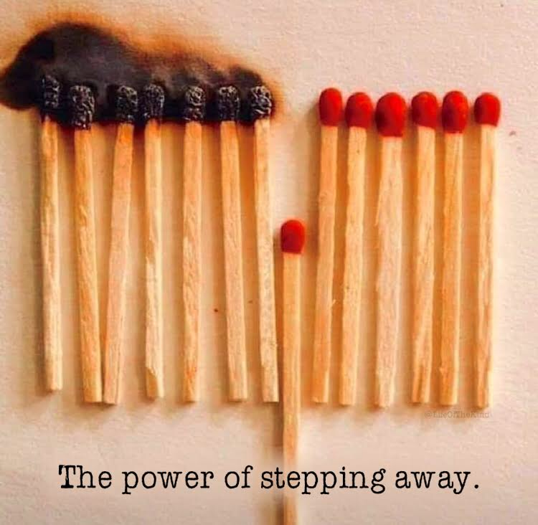

Slide 22
Biblical Conflict Resolution
Be sure to check your motives
Our desire to be right or win is often sinful
“If it is possible, as far as it depends on you, live at peace with everyone.” (Romans 12:18)

Slide 23
Biblical Conflict Resolution
Whatever you bind or loose…
Whatever believers decide concerning a brother who has refused to make things right with another whom he has offended, the church decision is God’s decision

Slide 24
Biblical Conflict Resolution
Whatever you bind or loose…
These are not just words or actions- these have eternal, heavenly importance!

