Slide 2
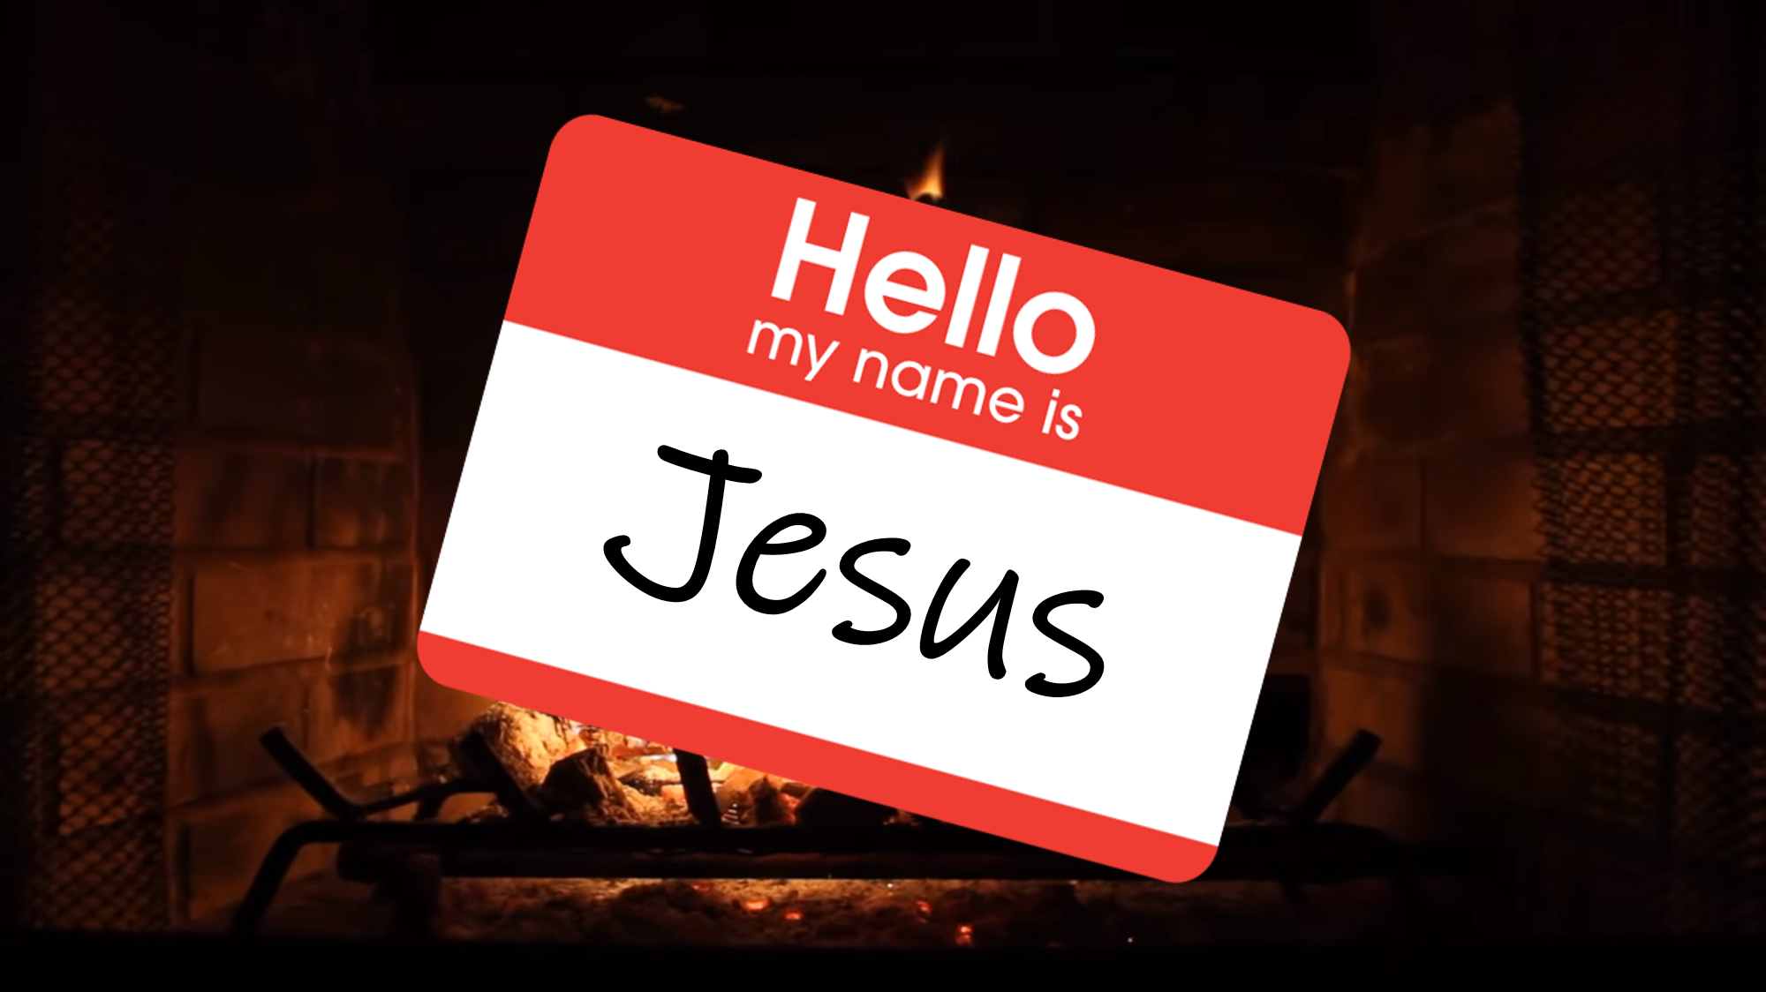

Slide 3
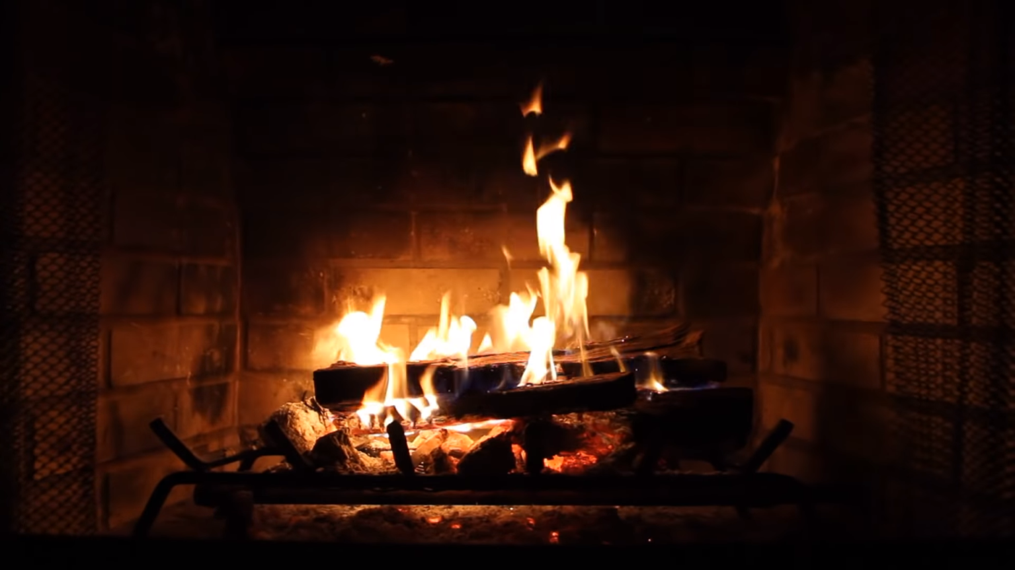
Isaiah 9:6-7
⁶ For a child will be born to us,
a son will be given to us; And the government will rest on His shoulders; And His name will be called Wonderful Counselor, Mighty God, Eternal Father, Prince of Peace.

Slide 4
Isaiah 9:6-7
⁷ There will be no end to the increase of His government or of peace, on the throne of David and over his kingdom, to establish it and to uphold it with justice and righteousness from then on and forevermore. The zeal of the Lord of hosts will accomplish this.

Slide 5
Characteristics of Christ’s Peace
Gal 5:22-23 But the fruit of the Spirit is love, joy, peace, forbearance, kindness, goodness, faithfulness, gentleness and self-control. Against such things there is no law.
1 Cor 14:33a For God is not a God of confusion but of peace…
Eph 4:3 Make every effort to keep the unity of the Spirit through the bond of peace.

Slide 6


Slide 7
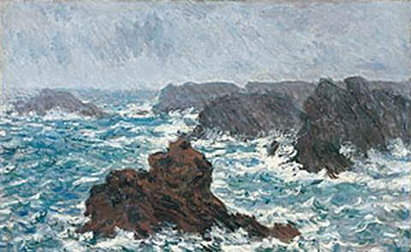

Slide 8
John 14:27
“Peace I leave with you;
My peace I give to you; not as the world gives do I give to you. Do not let your heart be troubled, nor let it be fearful.”

