Slide 2
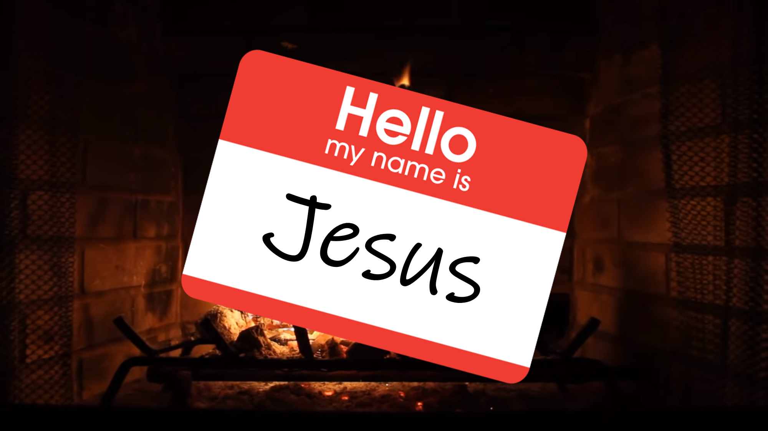

Slide 3
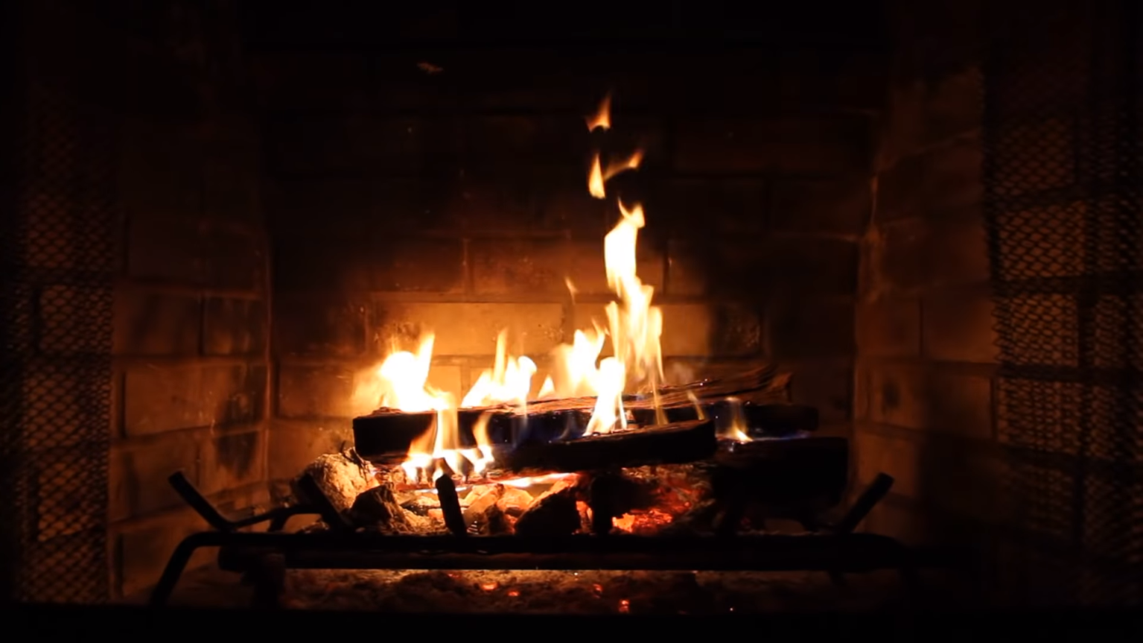
Acts 2:36
“Therefore let all the house of Israel know for certain that God has made Him both Lord and Christ—this Jesus whom you crucified.”

Slide 4
Acts 2:36
“Therefore let all the house of Israel know for certain that God has made Him both Lord and Christ—this Jesus whom you crucified.”

Slide 5
Lord
Kyrios

Slide 6
Matthew 8:8-10
⁸ But the centurion said, “Lord, I am not worthy for You to come under my roof, but just say the word, and my servant will be healed.

Slide 7
Matthew 8:8-10
⁹ For I also am a man under authority, with soldiers under me; and I say to this one, ‘Go!’ and he goes, and to another, ‘Come!’ and he comes, and to my slave, ‘Do this!’ and he does it.” ¹⁰ Now when Jesus heard this, He marveled and said to those who were following, “Truly I say to you, I have not found such great faith with anyone in Israel.”

Slide 8
Matthew 7:22-23
“Many will say to me on that day, ‘Lord, Lord, did we not prophesy in your name and in your name drive out demons and in your name perform many miracles?’ Then I will tell them plainly, ‘I never knew you. Away from me, you evildoers!’”

Slide 9
Know = ginosko
understand

Slide 10
1 John 2:3-4
We know that we have come to know him if we keep his commands. Whoever says, “I know him,” but does not do what he commands is a liar, and the truth is not in that person.

Slide 11
John 14:15
“If you love me, keep my commands.”

Slide 12
John 14:15
“If you love me, keep my commands.”

Slide 13
If you do not know who God is -
You can’t love Him,
If you do not know Him or love Him,
You won’t be able to obey the
commandments

Slide 14
Mark 12:28-34
²⁸ One of the scribes came and heard them arguing, and recognizing that He had answered them well, asked Him, “What commandment is the foremost of all?” ²⁹ Jesus answered, “The foremost is, ‘Hear, O Israel! The Lord our God is one Lord; ³⁰ and you shall love the Lord your God with all your heart, and with all your soul, and with all your mind, and with all your strength.’ ³¹ The second is this, ‘You shall love your neighbor as yourself.’ There is no other commandment greater than these.”

Slide 15
Mark 12:28-34
³² The scribe said to Him, “Right, Teacher; You have truly stated that He is One, and there is no one else besides Him; ³³ and to love Him with all the heart and with all the understanding and with all the strength, and to love one’s neighbor as himself, is much more than all burnt offerings and sacrifices.” ³⁴ When Jesus saw that he had answered intelligently, He said to him, “You are not far from the kingdom of God.”

Slide 16
Romans 14:17
For the kingdom of God… is righteousness and peace and joy in the Holy Spirit

Slide 17
Luke 4:43
“I must preach the kingdom of God to the other cities also, for I was sent for this purpose.”
That’s what we celebrate this season.
Jesus came to bring us back into the Kingdom of God

Slide 18
That God has made Him Lord…
Acts 2:36

Slide 19
Matthew 21:43
“Therefore I tell you that the kingdom of God will be taken away from you and given to a people who will produce its fruit.”

Slide 20
Galatians 5:22-23
The fruit of the Spirit is love, joy, peace, patience, kindness, goodness, faithfulness, gentleness, self-control.

Slide 21
Matthew 11:28-30
“Come to Me, all who are weary and heavy laden, and I will give you rest. Take My yoke upon you and learn from Me, for I am gentle and humble in heart, and you will find rest for your souls. For My yoke is easy and My burden is light.”

