Slide 2


Slide 3
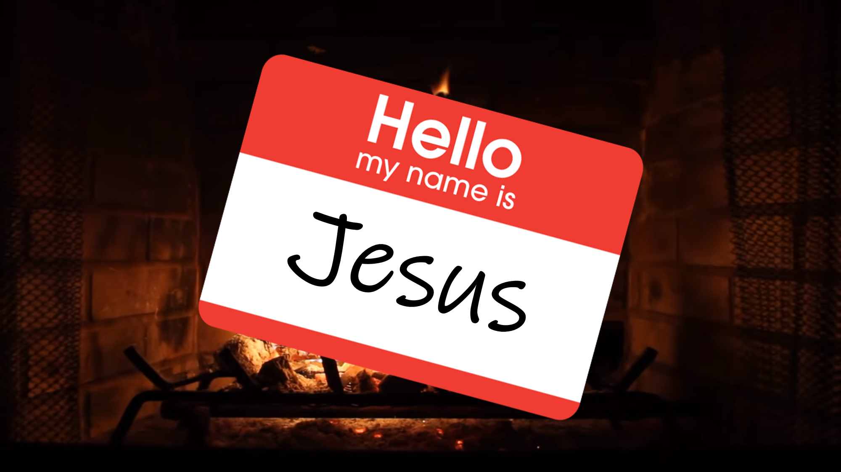

Slide 4
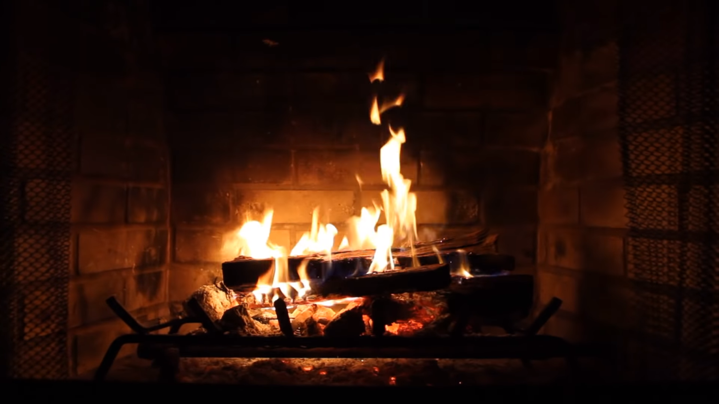
John 1:1,14
¹ In the beginning was the Word, and the Word was with God, and the Word was God. ¹⁴ The Word became flesh and made his dwelling among us. We have seen his glory, the glory of the one and only Son, who came from the Father, full of grace and truth.

Slide 5
2 Timothy 3:16-17
All Scripture is God-breathed and is useful for teaching, rebuking, correcting and training in righteousness, so that the servant of God may be thoroughly equipped for every good work.

