Slide 2
WEEK 2 | THE HEART OF GIVING

Slide 3
Philippians 3:12-14
¹² Not that I have already obtained all this, or have already arrived at my goal, but I press on to take hold of that for which Christ Jesus took hold of me. ¹³ Brothers and sisters, I do not consider myself yet to have taken hold of it. But one thing I do: Forgetting what is behind and straining toward what is ahead, ¹⁴ I press on toward the goal to win the prize for which God has called me heavenward in Christ Jesus.

Slide 4
Genesis 22:1-14

Slide 5
We spend most of our time here questioning God

Slide 6
“God Himself will provide the lamb”

Slide 7
“Now I know that you fear God, because you have not withheld from me…”

Slide 8
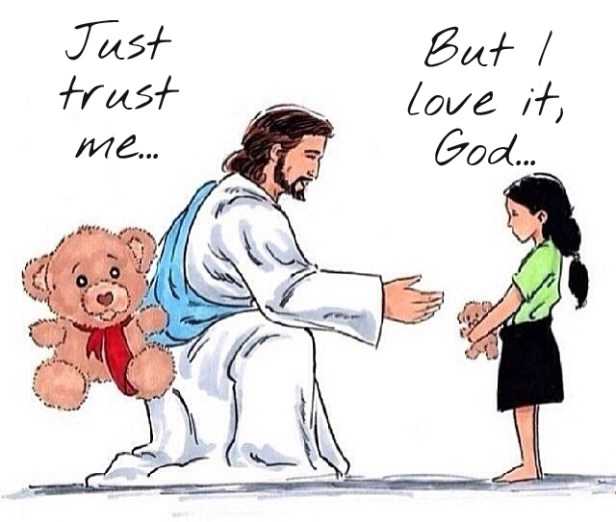

Slide 9
To fear God means we don’t fear losing something we have

Slide 10
Abraham modeled trusting that God will provide

Slide 11
“Now I know that you fear God, because you have not withheld from me…”

Slide 12
The Heart of Giving & The Heart of Obedience

Slide 13
Hosea 10:12 (ESV)
Sow for yourselves righteousness; reap steadfast love; break up your fallow ground, for it is the time to seek the Lord, that he may come and rain righteousness upon you.

