Slide 1


Slide 2

WEEK 4 | THE HEART OF MISSIONS

Slide 3
Greatest Commandment (Matthew 22:36-40)

Slide 4
Greatest Commandment (Matthew 22:36-40)
³⁶ “Teacher, which is the greatest commandment in the Law?”
³⁷ Jesus replied: “‘Love the Lord your God with all your heart and with all your soul and with all your mind.’ ³⁸ This is the first and greatest commandment. ³⁹ And the second is like it: ‘Love your neighbor as yourself.’ ⁴⁰ All the Law and the Prophets hang on these two commandments.”

Slide 5
“Love the Lord your God with all”
This is true worship.

Slide 6
“Love the Lord your God with all”
This is true worship.
Worship defined –
True worship is to love God with all of who you are, because He is worthy.
This is the reason why we exist.

Slide 7
‘Love your neighbor as yourself.’
Who is my neighbor?

Slide 8
‘Love your neighbor as yourself.’
Who is my neighbor?
– The other; Them; Those other than me.

Slide 9
‘Love your neighbor as yourself.’
Who is my neighbor?
– The other; Them; Those other than me.
As worshipers of God, if we truly love them, we will want them to fulfill their reason for being; which is to worship God.

Slide 11
Why Missions?

Slide 12
Why Missions?
“Missions exist because worship doesn’t.”
John Piper

Slide 13
“All of history is moving towards one great goal, the white hot worship of God and his Son among all the peoples of the earth. Missions is not that goal. It is the means.”
John Piper

Slide 14


Great Commission & Ascension

Slide 15
Great Commission (Matthew 28:18-20)

Slide 16
Great Commission (Matthew 28:18-20)
¹⁸ Jesus came and told his disciples, “I have been given all authority in heaven and on earth. ¹⁹ Therefore, go and make disciples of all the nations, baptizing them in the name of the Father and the Son and the Holy Spirit. ²⁰ Teach these new disciples to obey all the commands I have given you. And be sure of this: I am with you always, even to the end of the age.”

Slide 17
Great Commission (Acts 1: 8)

Slide 18
Great Commission (Acts 1: 8)
Jesus said:
“You will receive power when the Holy Spirit has come upon you, and you will be my witnesses in Jerusalem and in all Judea and Samaria, and to the end of the earth.”

Slide 19
Jerusalem – Your normal circles of influence
Judea – Your neighborhood; your acquaintances
Samaria – Those you avoid (Perhaps from a different culture or subculture)
End of the earth – Truly unreached peoples
(Those who have no Christian witness with-in their culture. If no one goes to tell them, they will never hear the good news about Jesus)

Slide 20
Jerusalem – Your normal circles of influence
Judea – Your neighborhood; your acquaintances
Samaria – Those you avoid (Perhaps from a different culture or subculture)
End of the earth – Truly unreached peoples
(Those who have no Christian witness with-in their culture. If no one goes to tell them, they will never hear the good news about Jesus)

Slide 21
Jerusalem – Your normal circles of influence
Judea – Your neighborhood; your acquaintances
Samaria – Those you avoid (Perhaps from a different culture or subculture)
End of the earth – Truly unreached peoples
(Those who have no Christian witness with-in their culture. If no one goes to tell them, they will never hear the good news about Jesus)

Slide 22
Jerusalem – Your normal circles of influence
Judea – Your neighborhood; your acquaintances
Samaria – Those you avoid (Perhaps from a different culture or subculture)
End of the earth – Truly unreached peoples
(Those who have no Christian witness with-in their culture. If no one goes to tell them, they will never hear the good news about Jesus)

Slide 23
Jerusalem – Your normal circles of influence
Judea – Your neighborhood; your acquaintances
Samaria – Those you avoid (Perhaps from a different culture or subculture)
End of the earth – Truly unreached peoples
(Those who have no Christian witness with-in their culture. If no one goes to tell them, they will never hear the good news about Jesus)

Slide 24
Jerusalem – Your normal circles of influence
Judea – Your neighborhood; your acquaintances
Samaria – Those you avoid (Perhaps from a different culture or subculture)
End of the earth – Truly unreached peoples
(Those who have no Christian witness within their culture. If no one goes to tell them, they will never hear the good news about Jesus)

Slide 25

Where are you called?
Jerusalem
Judea
Samaria
End of the earth

Slide 26
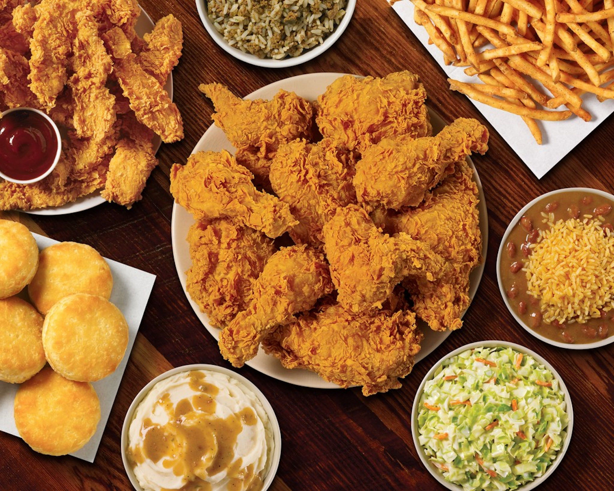

Slide 27
AND / OR

Slide 28
AND / OR
you will be my witnesses in Jerusalem or in all Judea or Samaria, or to the end of the earth

Slide 29
AND / OR
you will be my witnesses in Jerusalem or in all Judea or Samaria, or to the end of the earth
o or r

Slide 30
AND / OR
AND
“…and you will be my witnesses in Jerusalem and in all Judea and Samaria, and to the end of the earth.” (Acts 1:8)

Slide 31
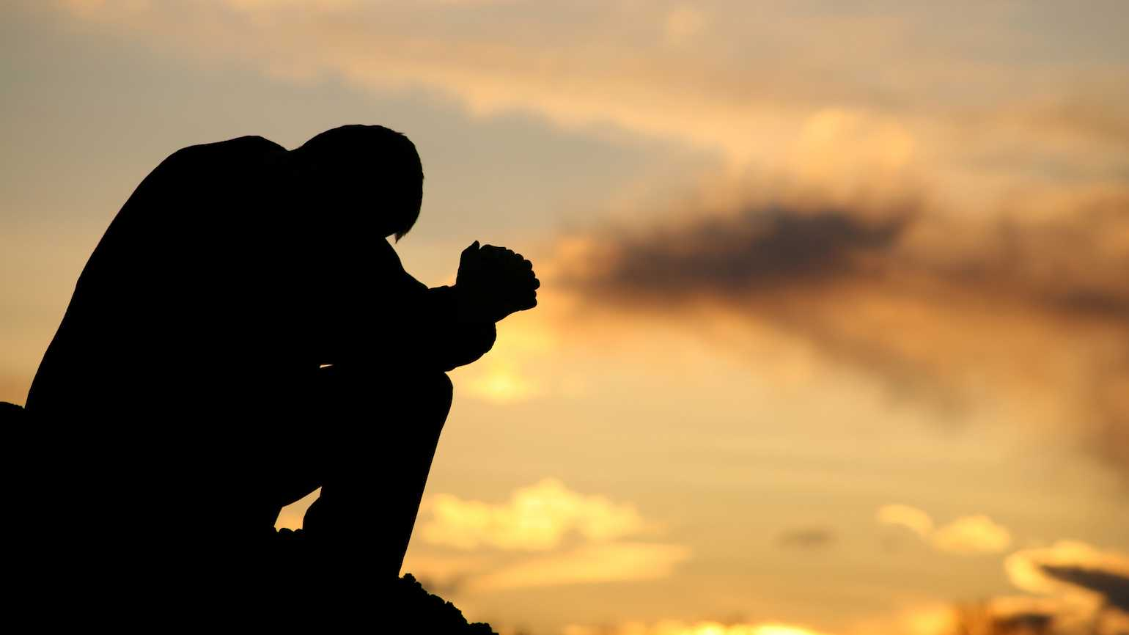
How to gain a Heart for Missions
Pray
Since it is God’s own heart, He will answer!

Slide 32
Give, GO, and Pray

Slide 33
Give, GO, and Pray
GIVE sacrificially as and act of worship

Slide 34
Give, GO, and Pray
GIVE sacrificially as and act of worship
GO where you are called

Slide 35
Give, GO, and Pray
GIVE sacrificially as and act of worship
GO where you are called
PRAY in faith, in line with God’s heart for the nations. He will answer.

Slide 36
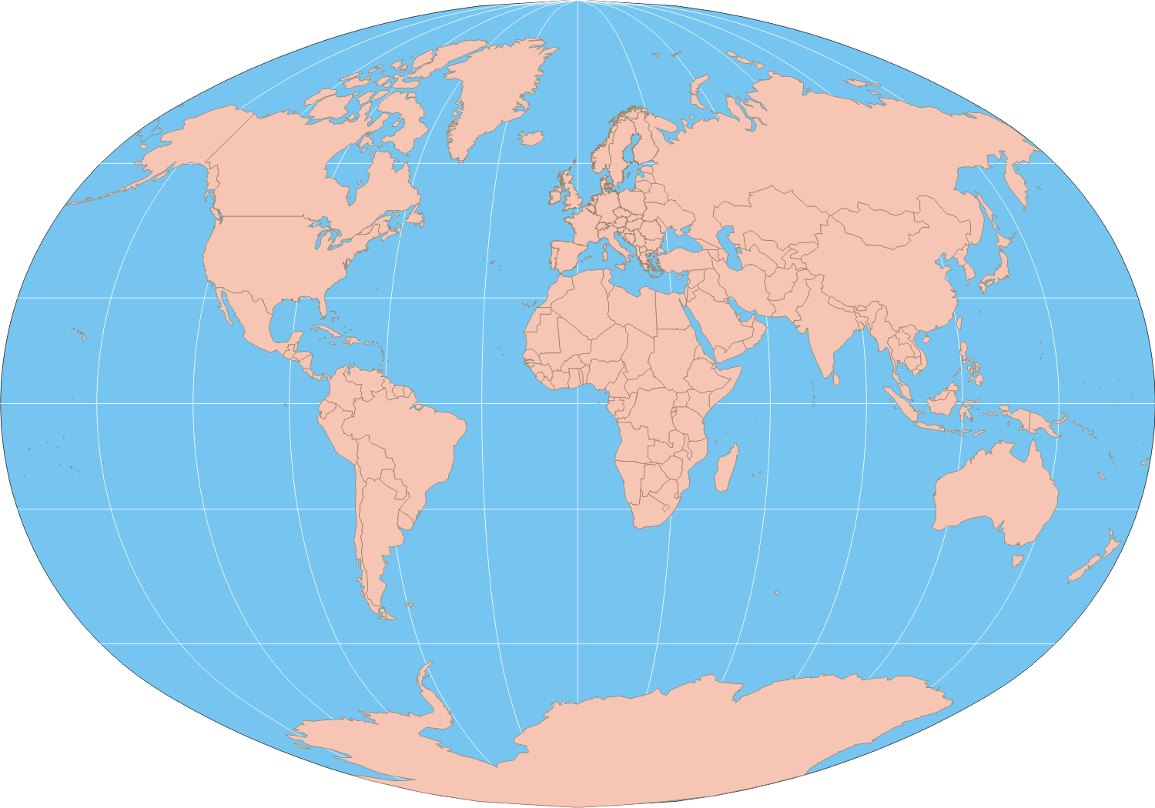
Commissioned Beyond Borders
Umatilla, FL
Ruth House
Umatilla, FL
Jose & Iva Roman
Chinese Students University of Alabama
Luc Saint Felix
Haiti
Luis & Maira Fuentes
Latino Americans
Lake County, FL
Off the Trail Missions
Pucallpa, Peru
$ 1600.00 Monthly
Missions Support
Sam & Jessica Hollis
Kenya, Africa

Slide 38
The Widow’s Offering (Luke 21:1-4)

Slide 39
The Widow’s Offering (Luke 21:1-4)
¹ While Jesus was in the Temple, he watched the rich people dropping their gifts in the collection box. ² Then a poor widow came by and dropped in two small coins. ³ “I tell you the truth,” Jesus said, “this poor widow has given more than all the rest of them. ⁴ For they have given a tiny part of their surplus, but she, poor as she is, has given everything she has.”

