Slide 2
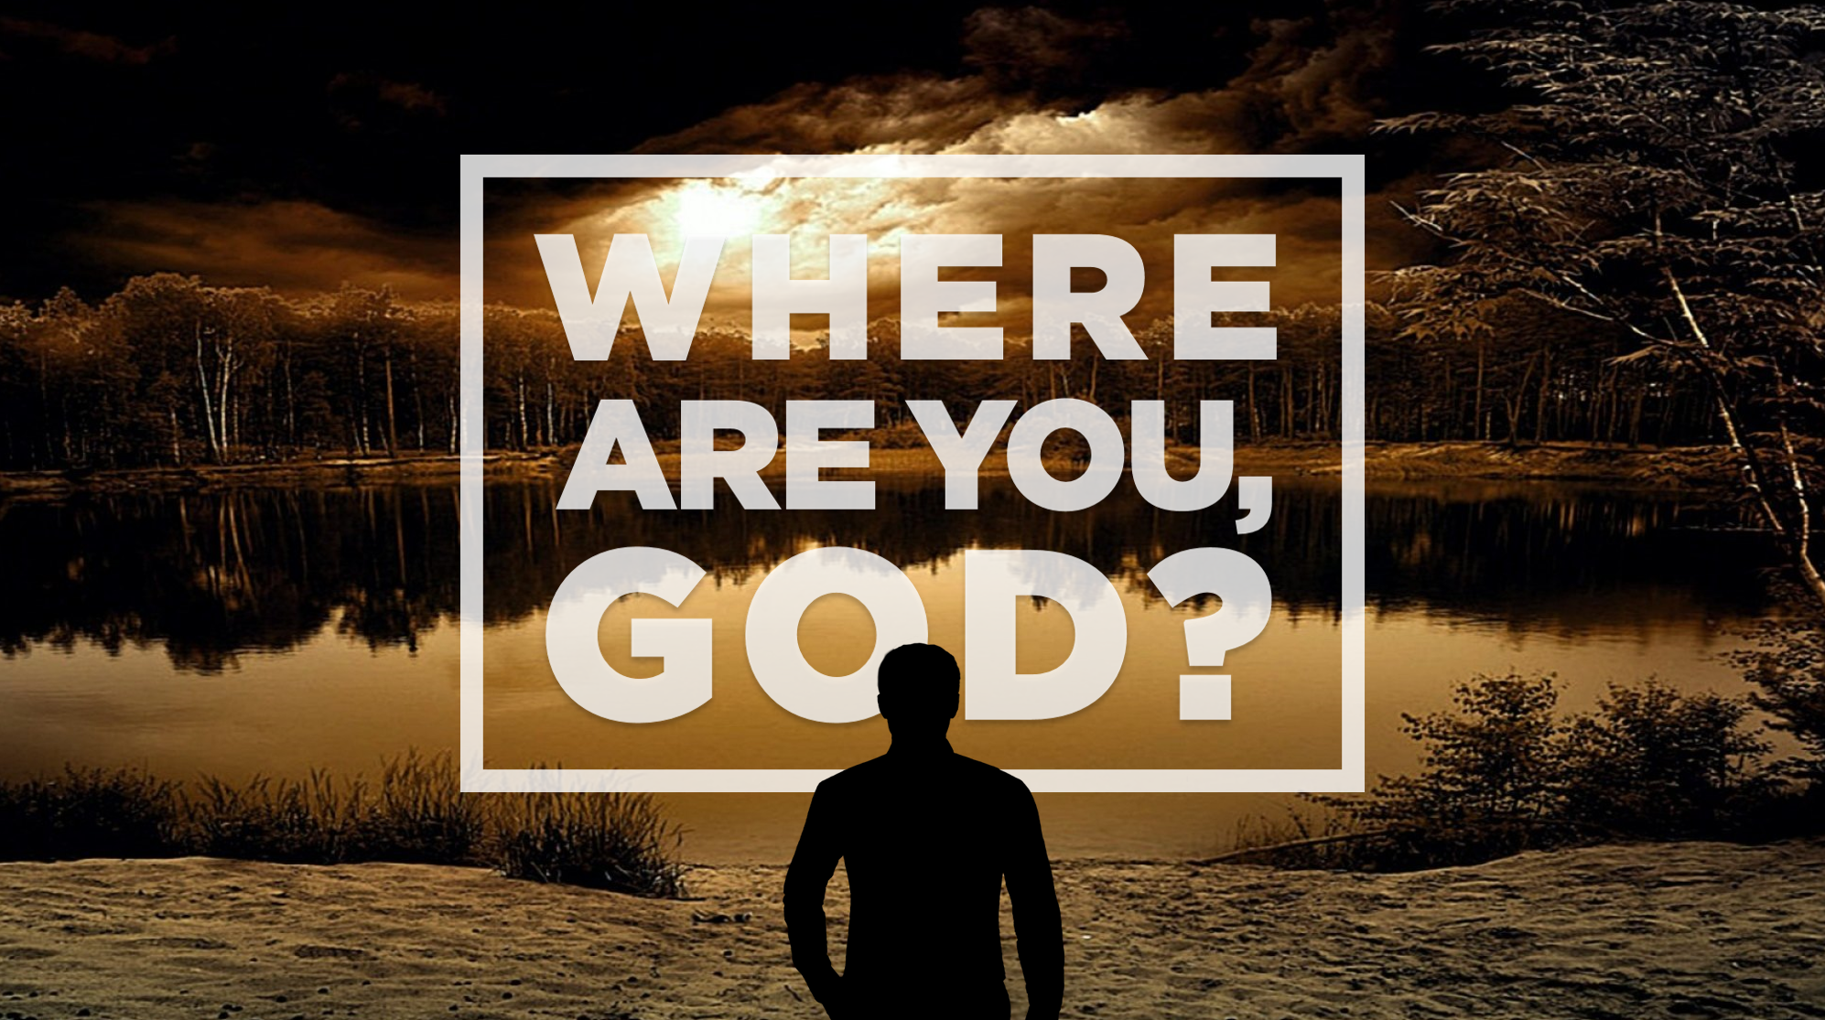

Slide 3
Week Two
In the Day of Adversity Consider…

Slide 4
Habakkuk 1:2 (NLT)
How long, O Lord, must I call for help? But you do not listen! “Violence is everywhere!” I cry, but you do not come to save.

Slide 5
Ecclesiastes 7:8-10

Slide 6
Ecclesiastes 7:13-14

Slide 7
Sovereignty of God
God is the supreme authority & all things are under His control
Easton's Bible Dictionary
defines God's Sovereignty as
His “absolute right to do all things according to His own
good pleasure”

Slide 8
Acts 2:23-24
²³ This man was handed over to you by God’s deliberate plan and foreknowledge; and you, with the help of wicked men, put him to death by nailing him to the cross. ²⁴ But God raised him from the dead, freeing him from the agony of death, because it was impossible for death to keep its hold on him.

Slide 9
Romans 8:28 (NASB)
And we know that God causes all things to work together for good to those who love God, to those who are called according to His purpose.

Slide 10
Ecclesiastes 7:15-18

Slide 11
Frustration
in what you can’t control

Slide 12
Focus instead on what you can control

Slide 13
Avoid all extremes

Slide 14
Ecclesiastes 8:14-17

Slide 15
“Worry is a
misuse of
imagination”
- unknown

Slide 16
“Anxiety does not empty tomorrow of its sorrows, but only empties today of its strength.”
-Charles Spurgeon

Slide 17
Ecclesiastes 3:11 (NLT)
Yet God has made everything beautiful for its own time. He has planted eternity in the human heart, but even so, people cannot see the whole scope of God’s work from beginning to end.

