Slide 3
Week Five
Wrestle with God!

Slide 4
Genesis 32:22-32

Slide 5
Wrestle with Who He is

Slide 6
Exodus 33:18-23

Slide 7
“Where I just was”

Slide 8
Wrestle with What He Does

Slide 9
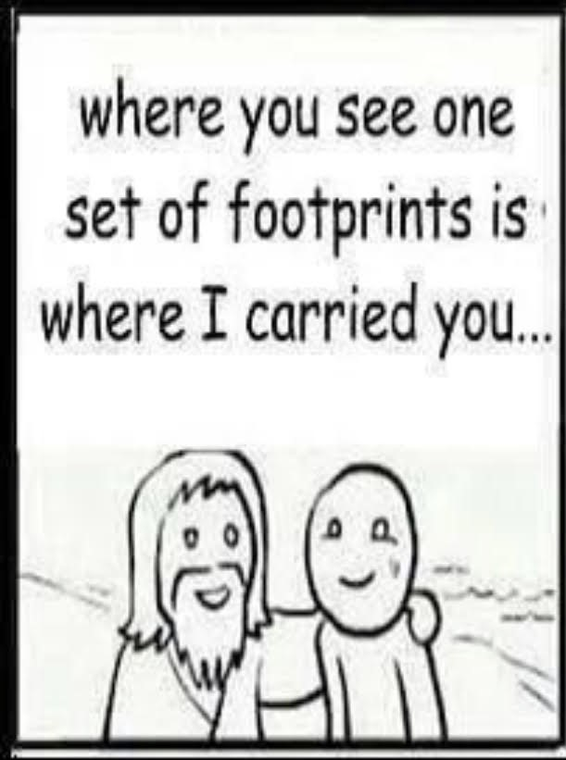

Slide 10
Wrestle with His Timing

Slide 11
Wrestle with What He Says

Slide 12
Bless- barak to congratulate

Slide 13
Wrestle with Victory

Slide 14
Wrestle with Your Identity

Slide 15
The call of Jesus is about wrestling, not settling for easy

