Slide 3
Week Four
When We Desperately Need God to Show Up! Part 2

Slide 4
Living by
The Word of the Lord

Slide 5
Elijah’s return to Ministry, following his time of preparation
1 Kings 18

Slide 6
Now it happened after many days that the word of the LORD came to Elijah in the third year, saying, "Go, show yourself to Ahab, and I will send rain on the face of the earth."
1Ki 18:1 NASB

Slide 7
Obadiah’s faith and fear

Slide 8
“Is that you, O troubler of Israel?”

Slide 9
1Ki 16:29-33 NASB
Ahab the son of Omri did evil in the sight of the LORD more than all who were before him. It came about, as though it had been a trivial thing for him to walk in the sins of Jeroboam the son of Nebat, that he married Jezebel the daughter of Ethbaal king of the Sidonians, and went to serve Baal and worshiped him.

Slide 10
So he erected an altar for Baal in the house of Baal which he built in Samaria. Ahab also made the Asherah. Thus Ahab did more to provoke the LORD God of Israel than all the kings of Israel who were before him.

Slide 11
God had set the stage for a showdown:
God or Baal?
1 Kings 18:20-35

Slide 12
“O LORD, the God of Abraham, Isaac and Israel, today let it be known that You are God in Israel and that I am Your servant and I have done all these things at Your word.
Answer me, O LORD, answer me, that this people may know that You, O LORD, are God, and that You have turned their heart back again. ”

Slide 13
Elijah, desperately needed God to show up.
He was confident that God would honor HIS WORD!

Slide 14
The Fire Fell!
The Rain Came !!
God showed up!!!

Slide 15
Elijah ran toward Jezebel!
(approx. 17 miles)
Then he ran away from Jezebel!
(approx. 100 miles)
Then he went another day’s journey, and sat down under a juniper tree.

Slide 16
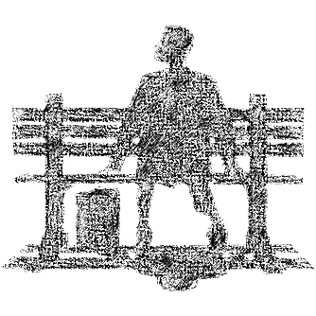
“I’m pretty tired…
I think I’ll go home now.”
“I have had enough, Lord. Take my life; I am no better than my ancestors” (1 Kings 19:4)

Slide 17
BURN OUT!

Slide 18
The Juniper Tree
Another lesson in provision
“He maketh me lie down…”

Slide 19
The Cave

